Slide 1
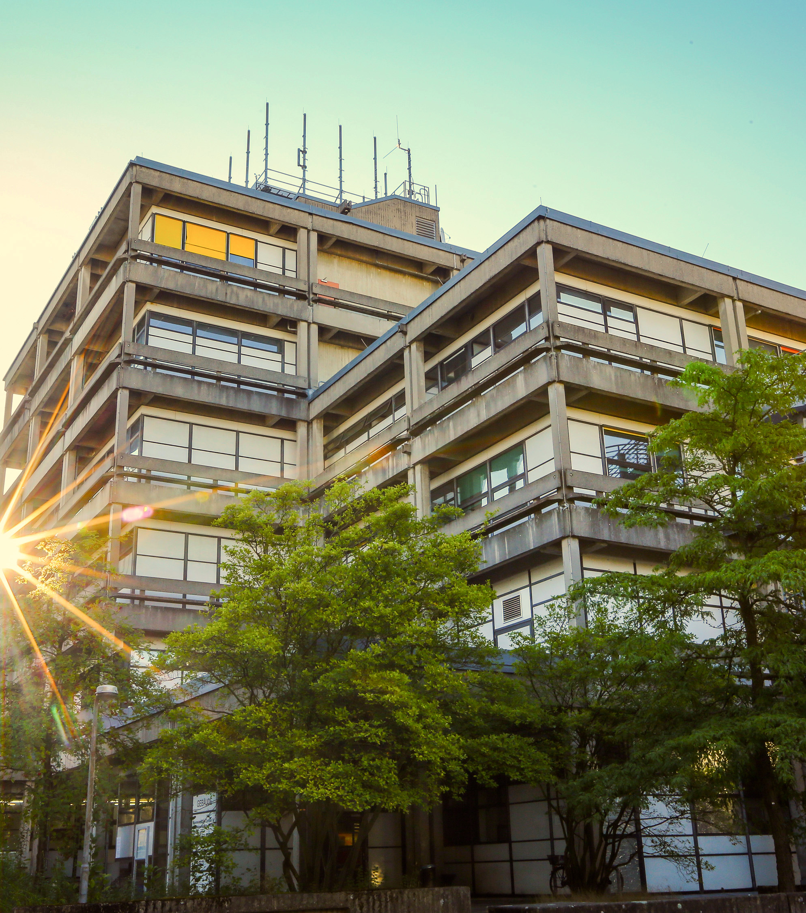

Short summary of important information
Student Orientation of the
Student Council MatheInfo
fachschaft@mathematik.uni-marburg.de

Slide 2
Topics
Examination regulations
Modules
  Lectures
  Exams
  Further types of modules
Das erste Semester
Gebäude der Uni
  Das Mehrzweckgebäude
Studienberatung
Nicht-Studien Angebote an der Uni
Verlauf der Orientierungseinheit
fachschaft@mathematik.uni-marburg.de

Slide 3
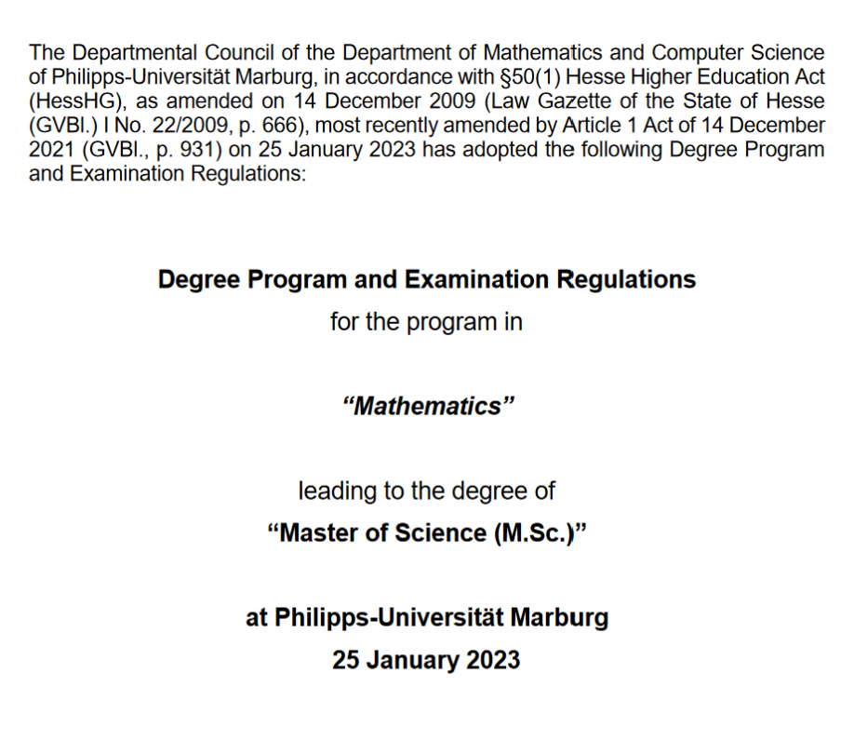
Examination regulations
„Contract“ between Students and University
https://www.uni-marburg.de/de/fb12/studium/pruefungsordnungen/master-pruefungsordnungen
Format: Year + Semester
1 - Summer term
2 - Winter term
20232 – Applies to all students starting in oder after the winter term 2023 until the next regulation
fachschaft@mathematik.uni-marburg.de

Slide 4
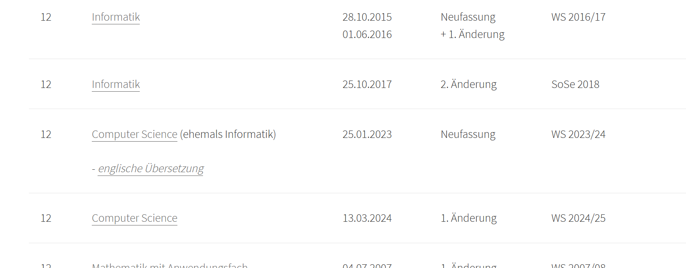
Examination regulations
Find all Examination regulation under the following link
https://www.uni-marburg.de/de/universitaet/administration/recht/studprueo/02-masterstudiengaenge
fachschaft@mathematik.uni-marburg.de

Slide 5
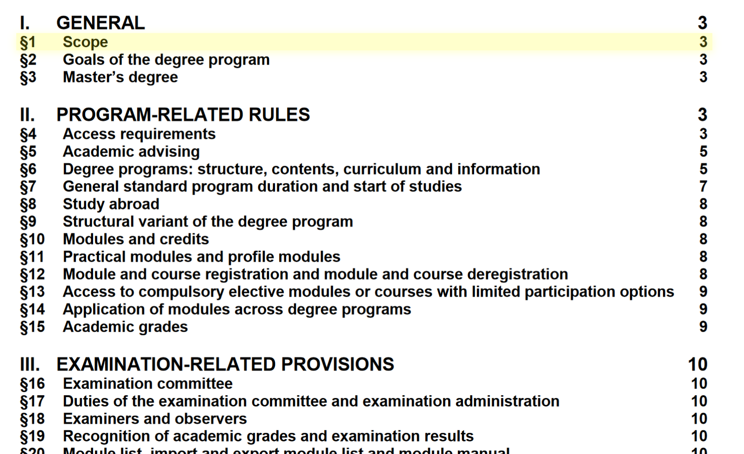
Examination regulations

Slide 6
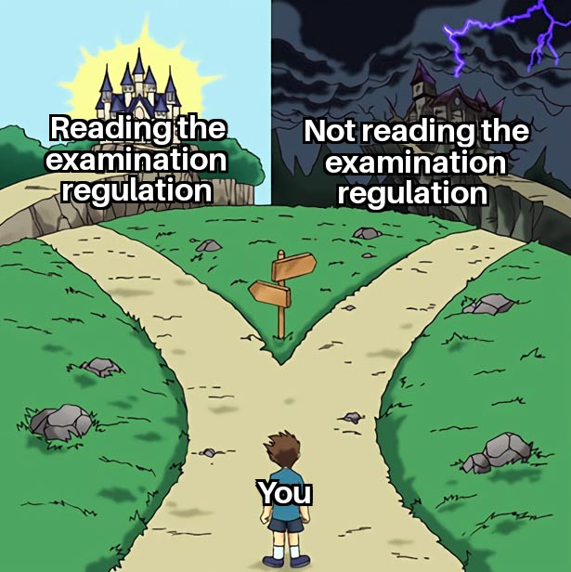
Examination regulations

Slide 7
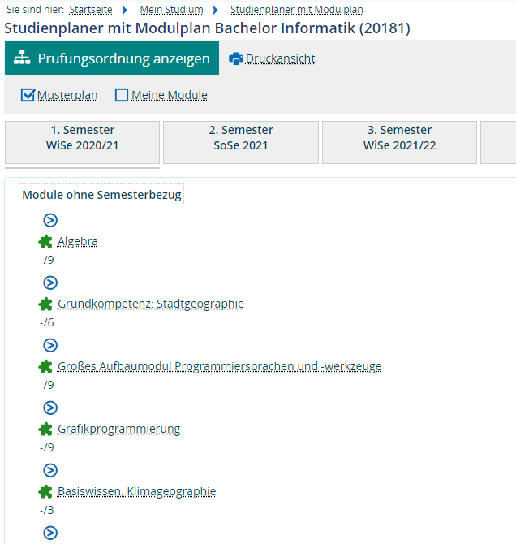
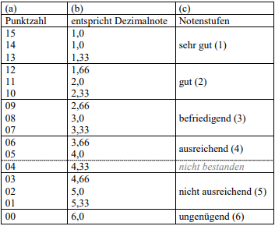
Modules
Building blocks of the degree program
  Under Marvin → My studies → Study planner with module plan
  Types of modules
    Lecture
    Seminar
    Internship
    Final thesis
  Completion by module examination
    Oral or written
    If passed, ECTS points (also CP, LP) are awarded
    1 CP = 30 hours of work
Usually 30 CP per semester
Master’s degree: 120 CP
fachschaft@mathematik.uni-marburg.de

Slide 8
Lectures
Lecture to convey the content
    Listening, taking notes
    Asking questions
Tutorials/exercises for revision
    Led by students from higher semesters
    Asking questions
    Discussing notes
Central exercises
No registration (for participation) for modules of Department 12
Officially no compulsory attendance
    But...
fachschaft@mathematik.uni-marburg.de

Slide 9
Exam
Completion of a module
For lectures: Written or oral examination
    Prerequisite for admission: academic achievement
Four attempts per module
Registration
    Using TAN list
Second examination appointment
    Registration just like for the first appointment, but after the first examination date
fachschaft@mathematik.uni-marburg.de

Slide 10
Further types of modules
Registration by e-mail to the examination office (currently very busy)
Seminars
    Examination: presentation and written elaboration
Practical modules
    Examination: Individual
Final thesis
    Examination: Submission and presentation
fachschaft@mathematik.uni-marburg.de

Slide 11
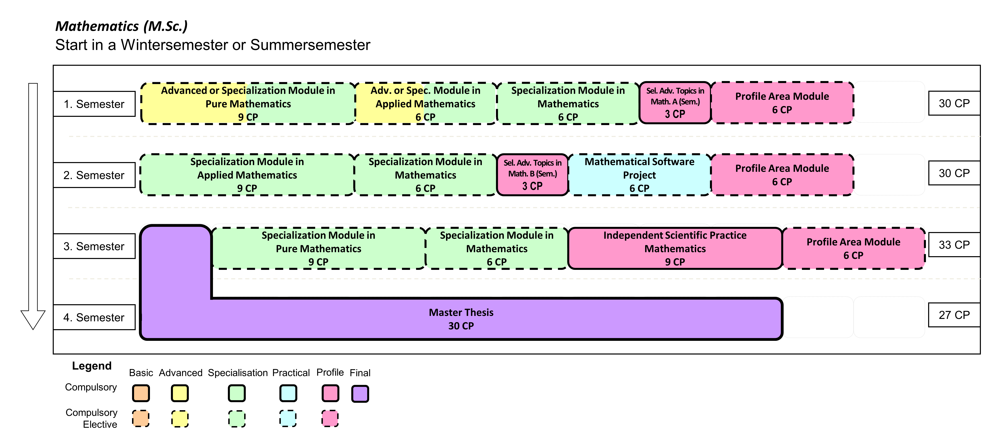
Recommended order of study
fachschaft@mathematik.uni-marburg.de

Slide 12
Course work for admission under a condition
Some new master’s students have modules that they have to pass in a certain timeframe (usually 4 Semesters) as a codition for their admission
  Only need to be passed
  Participation in the exam is always possible for those modules
    → Technically not obligated to do exercise sheets
        We still strongly advice doing them!
fachschaft@mathematik.uni-marburg.de

Slide 13
Important Buildings
Main lecture building (Biegenstraße)
University Library (Pilgrimstein)
Renthof (Physik)
Mehrzweckgebäude (Lahnberge)
Old chemistry building (Lahnberge)
fachschaft@mathematik.uni-marburg.de

Slide 14
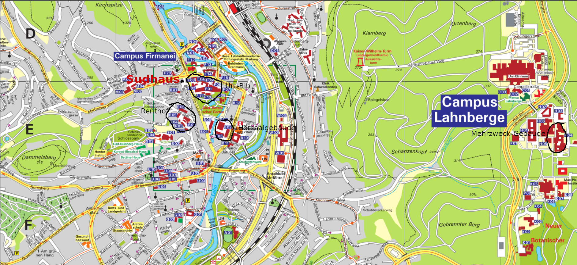
Important Buildings
fachschaft@mathematik.uni-marburg.de

Slide 15
Important rooms in the Mehrzweckgebäude
Examination Office: 05A29
Department Library: 04D11
Learning Center: 03A01
HRZ-Helpdesk: 06A03
Parent-Child Room: 04A27
Office of the Student Council: 04D04
Room description
  05 = Level (Entrance is on level 3)
  D = Core
  29 = Room
fachschaft@mathematik.uni-marburg.de

Slide 16
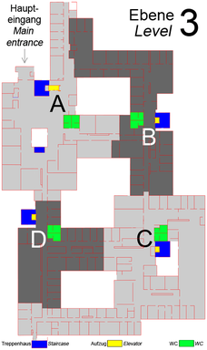
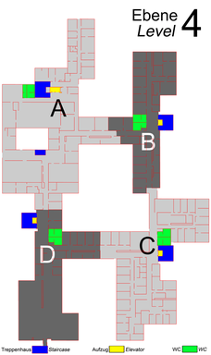
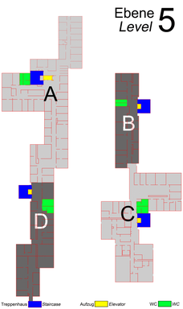
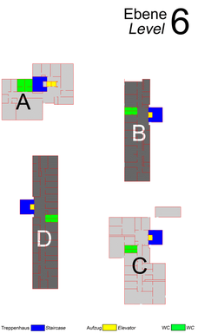
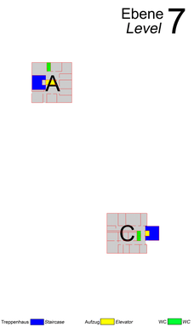
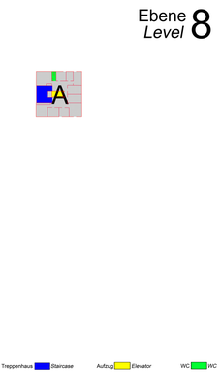
Eine Übersicht der Etagen des Mehrzweckgebäude

Slide 17
Academic Advising
Student Council: fachschaft@mathematik.uni-marburg.de
Advisor of the department: https://www.uni-marburg.de/en/fb12/department/representatives/study-advice
Central offers: https://www.uni-marburg.de/en/studying/services
fachschaft@mathematik.uni-marburg.de

Slide 18
Outside the lecture hall
Uni-Sport
  Register as early as possible, courses are filled very quickly!
  https://www.uni-marburg.de/de/zfh
Bunte Liga (marburg.die-bunte-liga.de )
Language Courses (https://www.uni-marburg.de/de/sprachenzentrum/sprachen, https://www.uni-marburg.de/de/studienkolleg)
Music
  Uni-Choir (https://www.uni-marburg.de/de/hosting/unichor)
  Student Orchestra (https://www.sso-marburg.de/)
  Student-BigBand (https://www.studibigband-marburg.de)
Student Council (great!)
fachschaft@mathematik.uni-marburg.de

Slide 19
Student Council
Representation of interests of all students of the faculty
https://www.uni-marburg.de/de/fb12/fachbereich/fachschaft
Activities:
  Committee work
  Counseling
  Events (Games evenings, Feuerzangenbowle, ...)
  Student Council
fachschaft@mathematik.uni-marburg.de

Slide 20
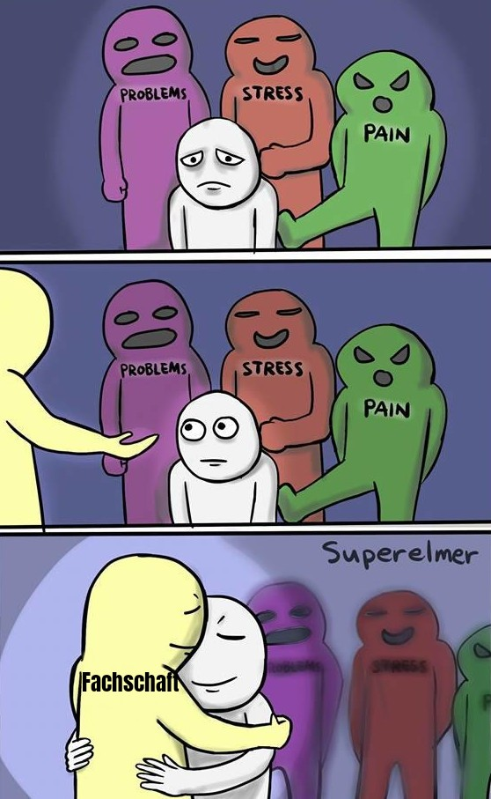
Student Council
fachschaft@mathematik.uni-marburg.de

Slide 21
Further questions?
fachschaft@mathematik.uni-marburg.de

