Slide 1
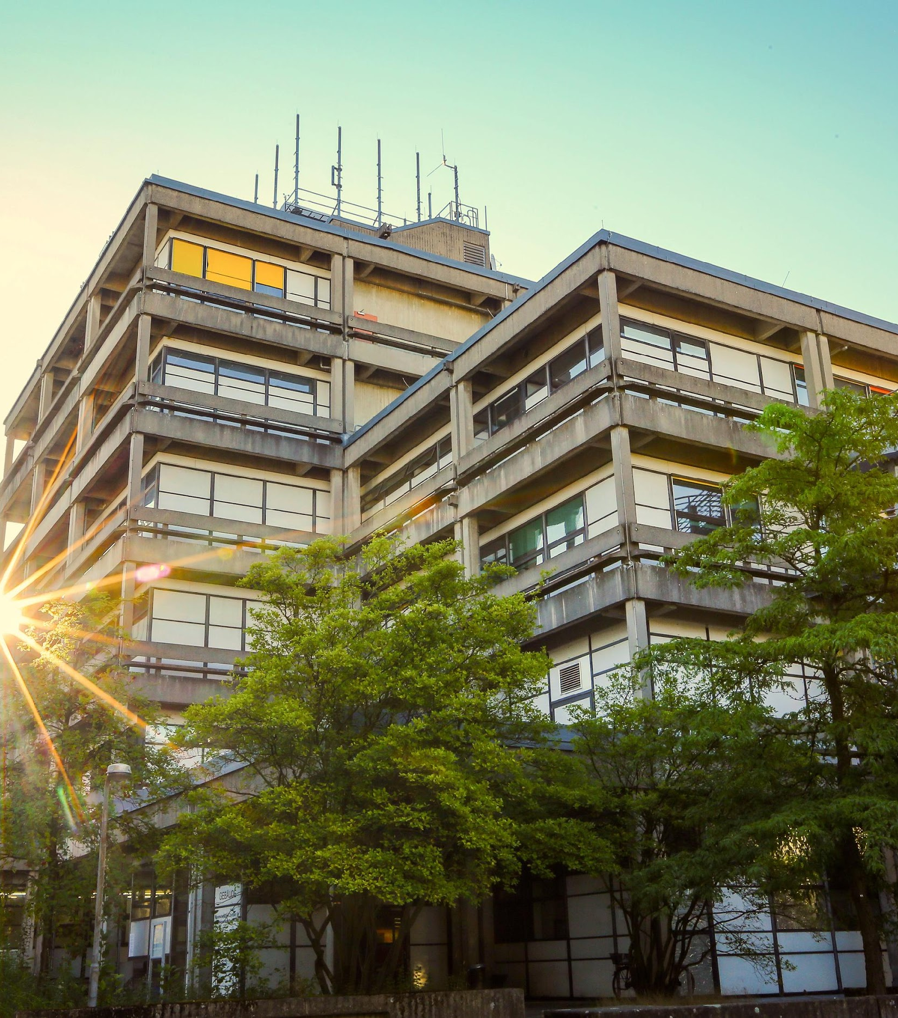

Introduction of
the Student Council
Student Orientation
Mathematics and Computer Science
fs-matheinfo.de
fachschaft@mathematik.uni-marburg.de
Notes:
‹#›

Slide 2
Who are we
Collection of the Students of the department
  „active Student Council“
Represent you in different with full voting rights
  Departmental Council
  Conference of Student councils
  Examination committees
  etc.
Planning events for students
OE, graduation party, movie nights
First Semester Students Party
„Very cool people“
fachschaft@mathematik.uni-marburg.de
fs-matheinfo.de
Notes:
‹#›

Slide 3

Party
fachschaft@mathematik.uni-marburg.de
fs-matheinfo.de
Notes:
‹#›

Slide 4
How can we help you?
General questions about the study
Old exams
Oral examination protocols
Problems with lecturers or other students
Mediation of problems that we cannot solve directly
fachschaft@mathematik.uni-marburg.de
fs-matheinfo.de
Notes:
‹#›

Slide 5
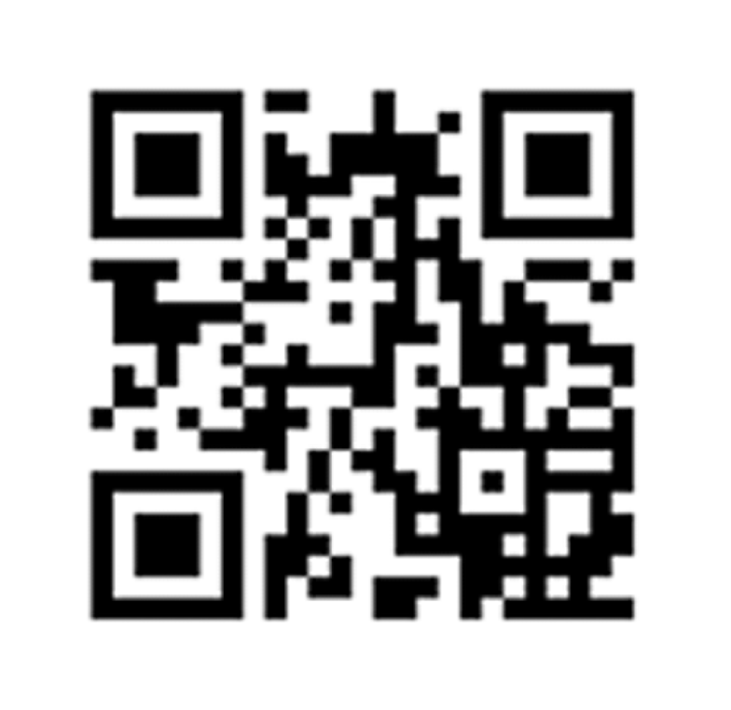

When do we meet up?
Is it possible to join you? With pleasure!
  Join the group!
Next week on Tuesday after next at 18:00 in the student council room (04D04).
  we will give an introduction to the student council to the new people
We are often in pubs afterwards
We do not bite (...mostly)
fachschaft@mathematik.uni-marburg.de
fs-matheinfo.de
Notes:
‹#›

Slide 6
Outlook for today
Breakfast...
10:30 Welcome from the Department
11:30 Small group discussion about the master
13:00 Lunch break
14:00 Lahnberge Campus Ralley (Meeting in the Foryer)
fachschaft@mathematik.uni-marburg.de
fs-matheinfo.de
Notes:
‹#›

Slide 7
Outlook for the week
Wednesday:
City rallye, meeting point Mensa Lahntal
Thursday:
13:30 Recap for late arrivals
Afterwards: Introduction to university Portals
15:00 Introduction to department accounts and services
Afterwards: Where to go in case of problems during your studies
Afterwards: Tips for your studies
~ 17:00 Board game evening in the foyer
fachschaft@mathematik.uni-marburg.de
fs-matheinfo.de
Notes:
‹#›

Slide 8
Thank you!
Webseite
  https://fs-matheinfo.de
Discord
Bulletin board (Job offers and more): brett.fs-matheinfo.de
Instagram: @matheinfo
E-Mail: fachschaft@mathematik.uni-marburg.de
fachschaft@mathematik.uni-marburg.de
fs-matheinfo.de
Notes:
‹#›

