Slide 1
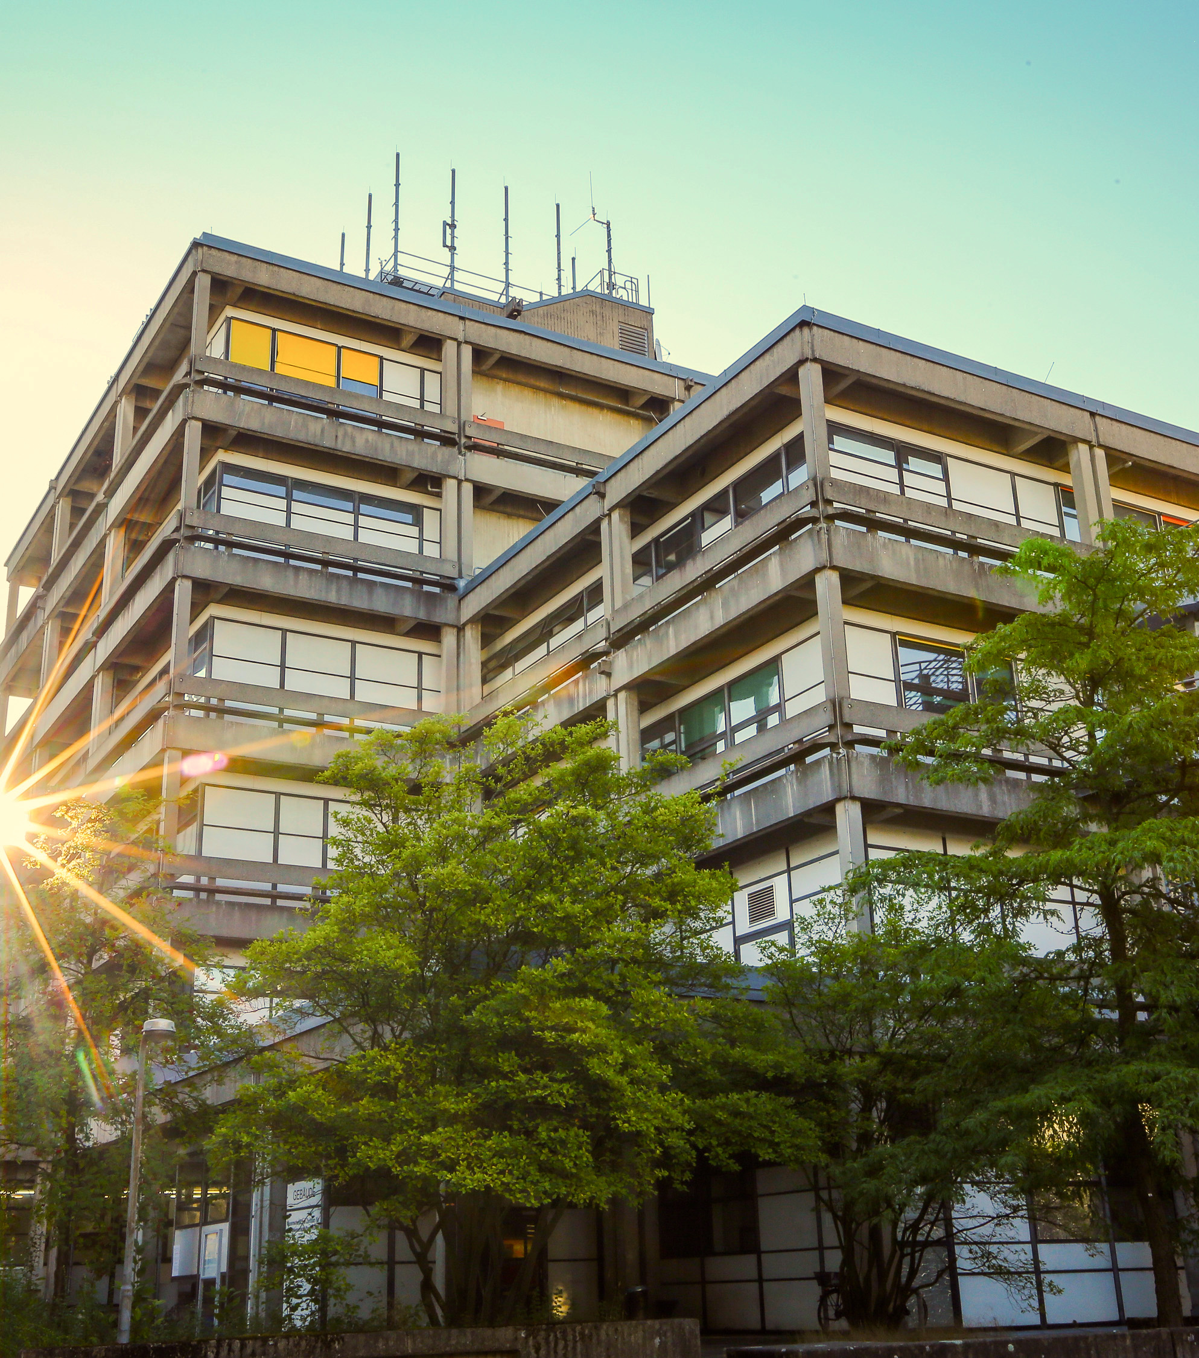

Department & Uni-Services
Student Orientation of the Student Council MatheInfo
fachschaft@mathematik.uni-marburg.de

Slide 2
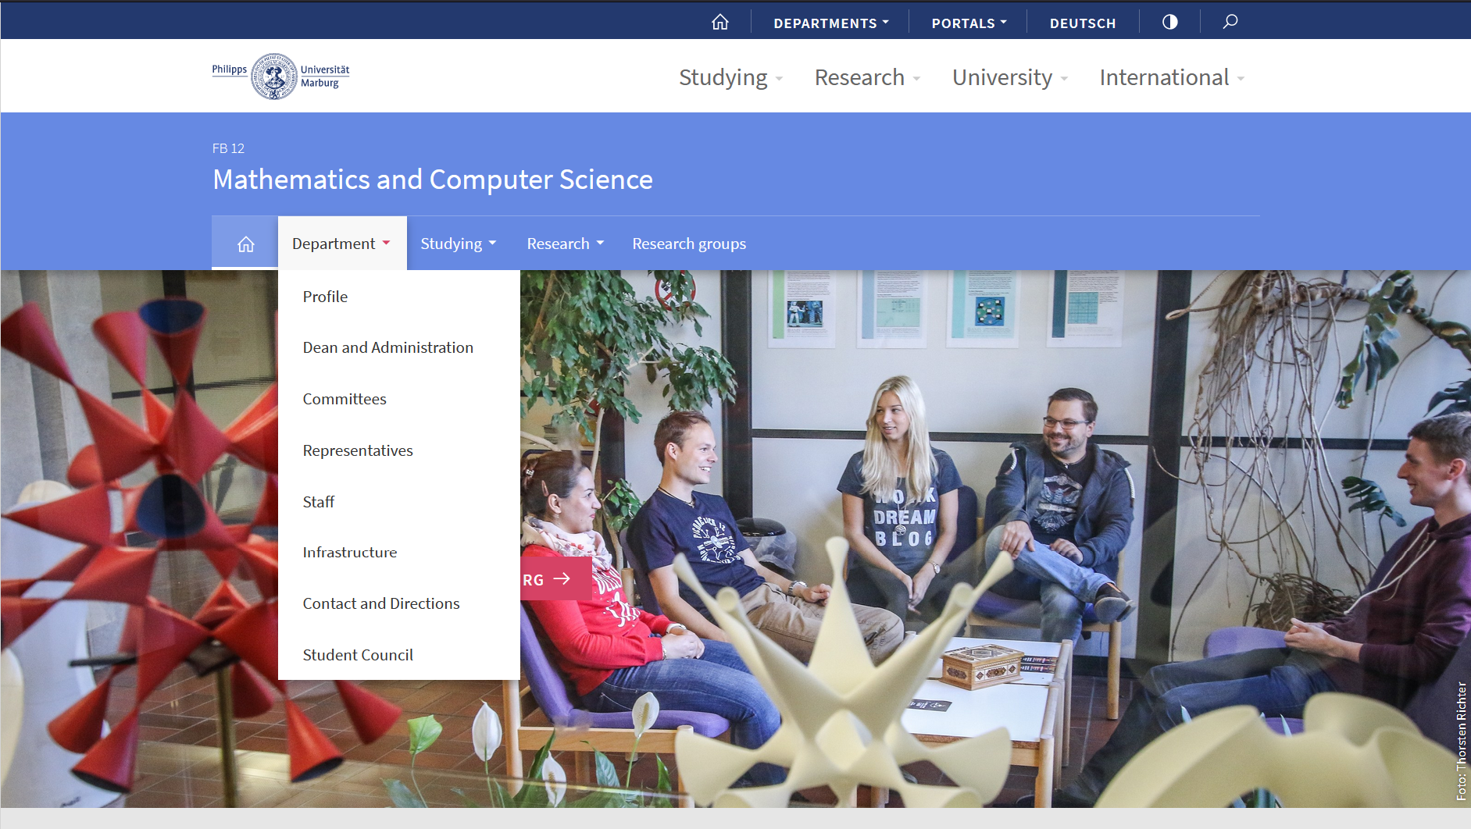
Exkurs: Department
fachschaft@mathematik.uni-marburg.de
Notes:
<Foliennummer>

Slide 3
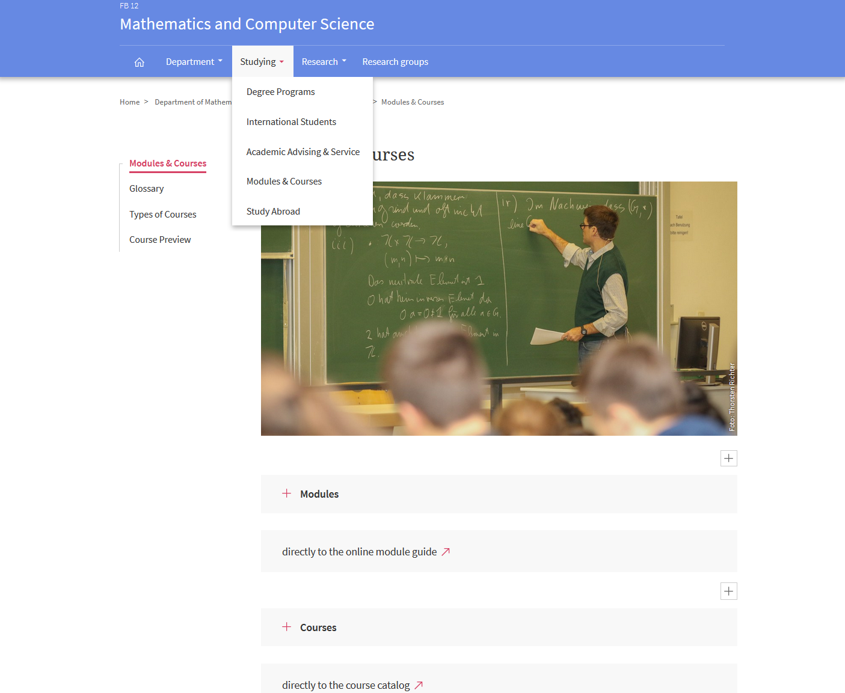
Exkurs: Fachbereich
fachschaft@mathematik.uni-marburg.de
Notes:
<Foliennummer>

Slide 4
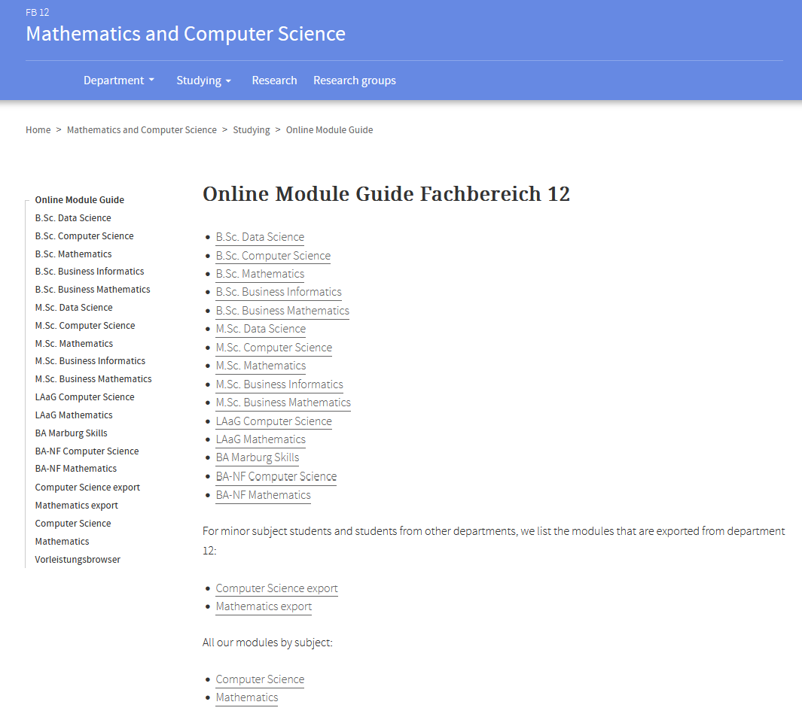
Exkurs: Module Guide
fachschaft@mathematik.uni-marburg.de
Notes:
<Foliennummer>

Slide 5
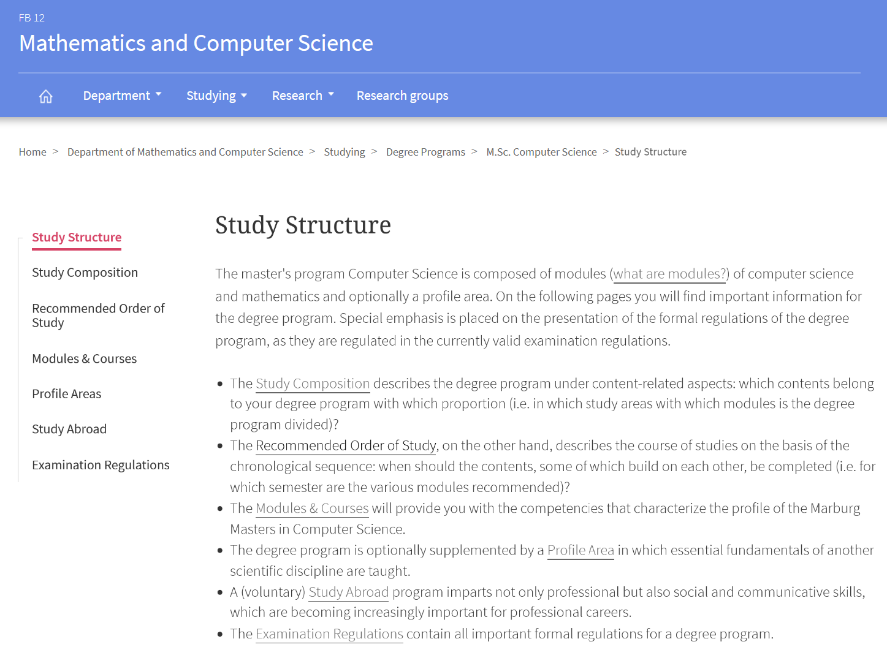
Exkurs: Study Structure
fachschaft@mathematik.uni-marburg.de
Notes:
<Foliennummer>

Slide 6
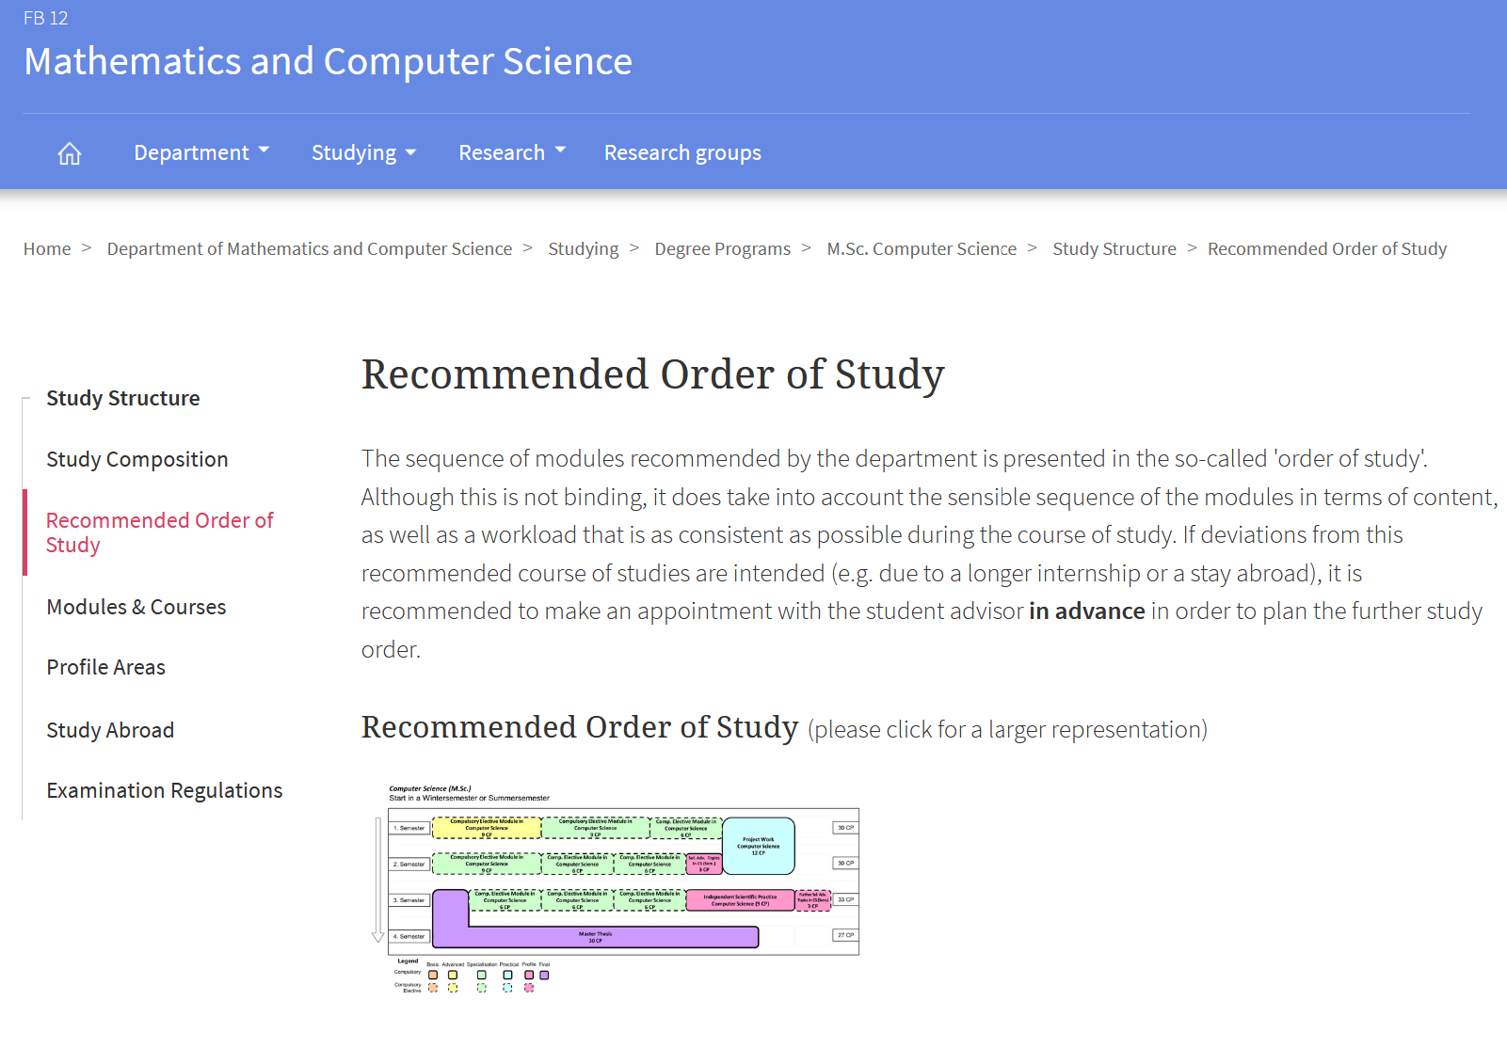
Exkurs: Recommended Order of Study
fachschaft@mathematik.uni-marburg.de
Notes:
<Foliennummer>

Slide 7
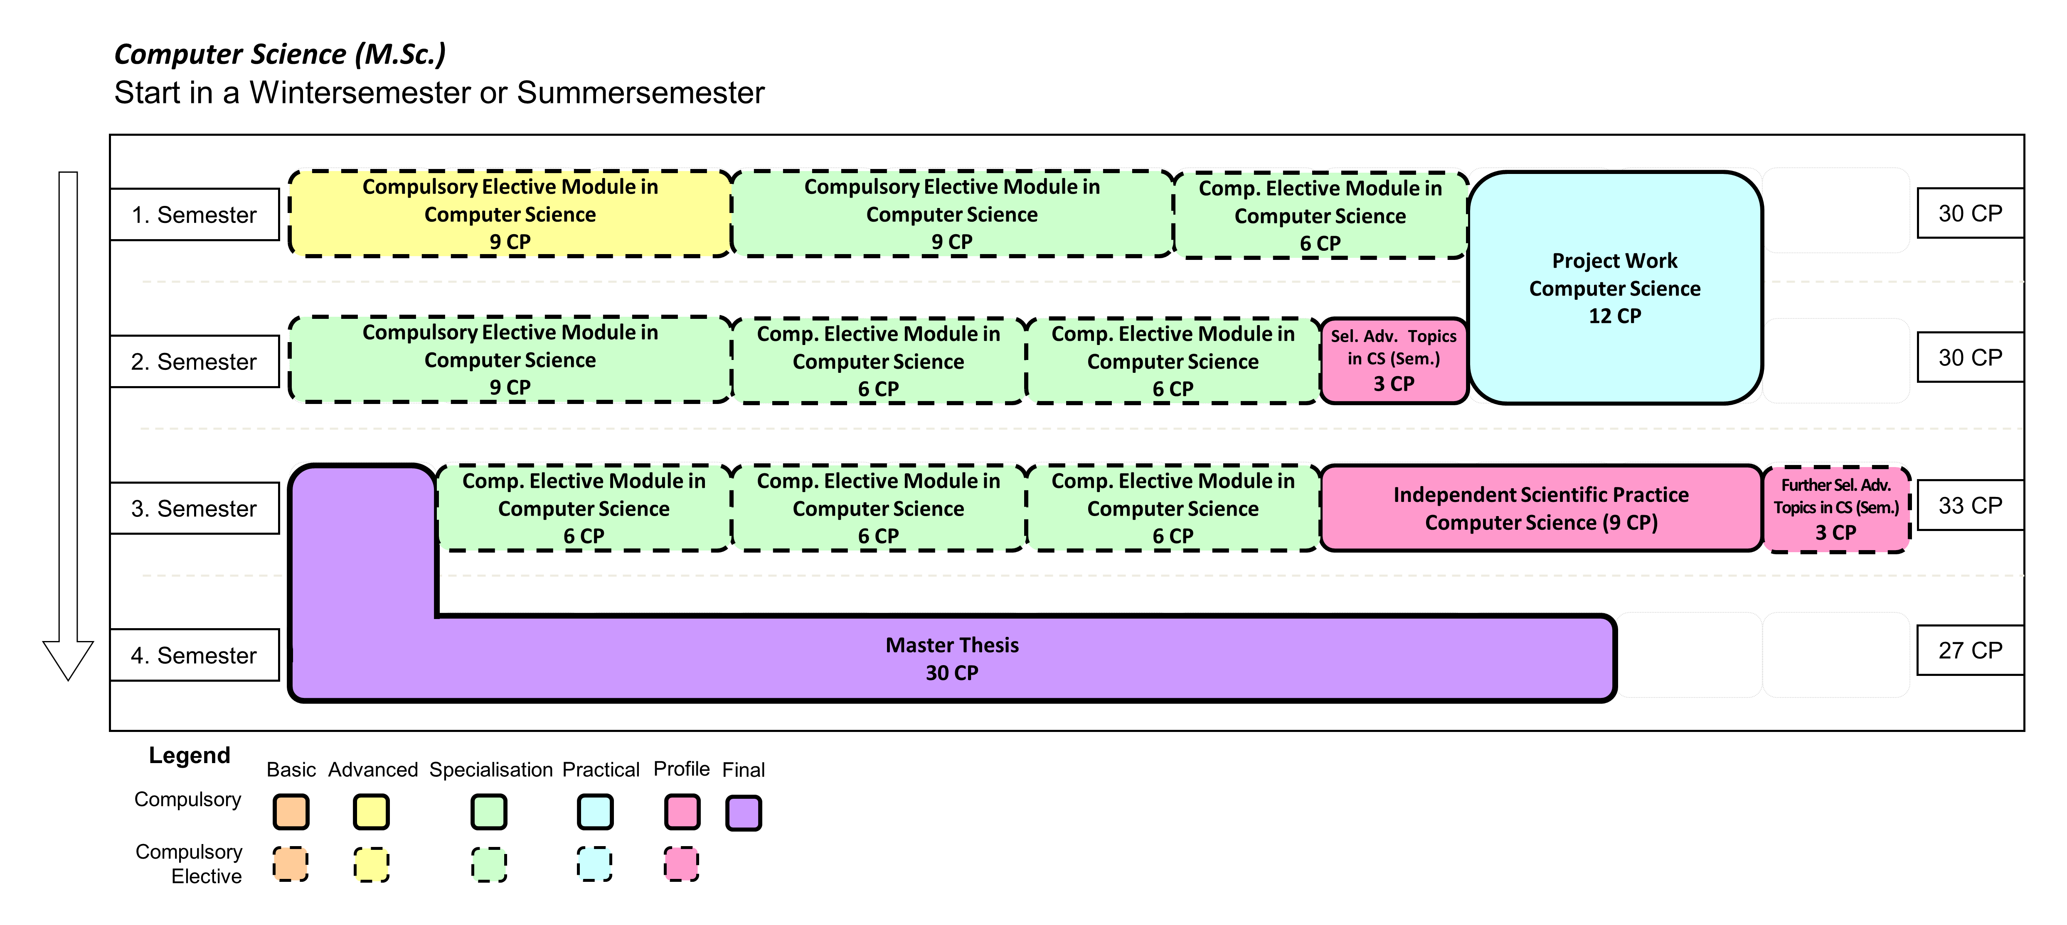
Exkurs: Recommended Order of Study
fachschaft@mathematik.uni-marburg.de
Notes:
<Foliennummer>

Slide 8
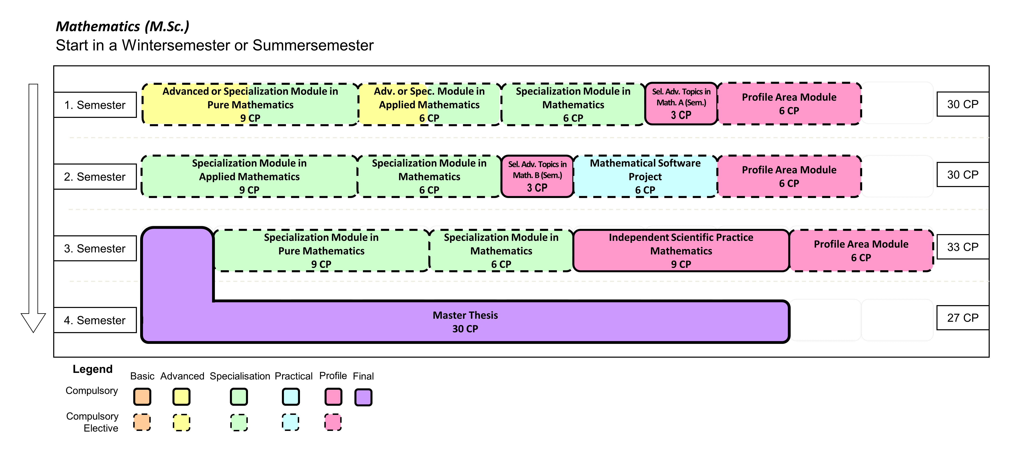
Exkurs: Recommended Order of Study
fachschaft@mathematik.uni-marburg.de
Notes:
<Foliennummer>

Slide 9
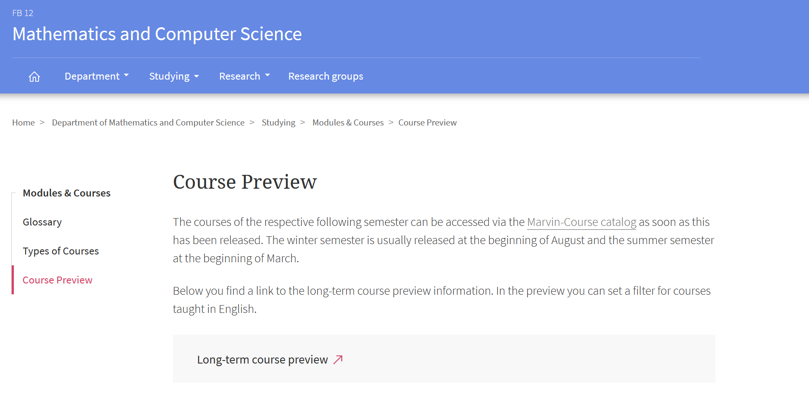
Exkurs: Course preview
fachschaft@mathematik.uni-marburg.de
Notes:
<Foliennummer>

Slide 10
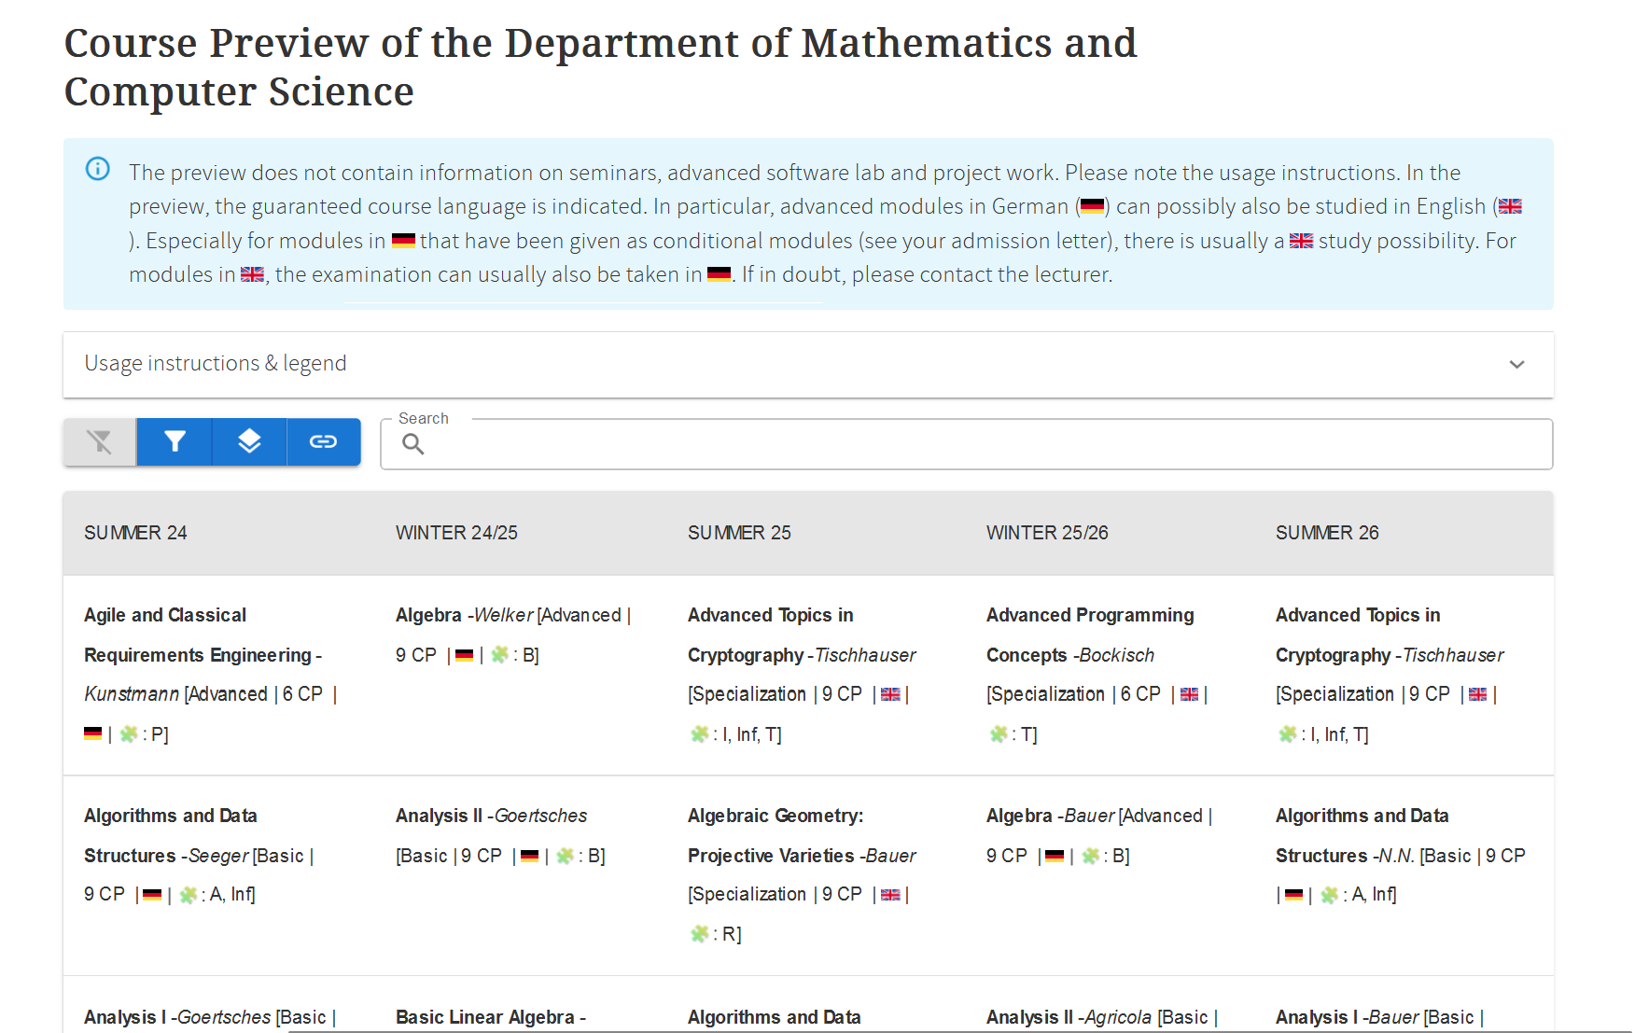
Exkurs: Course preview
fachschaft@mathematik.uni-marburg.de
Notes:
<Foliennummer>

Slide 11
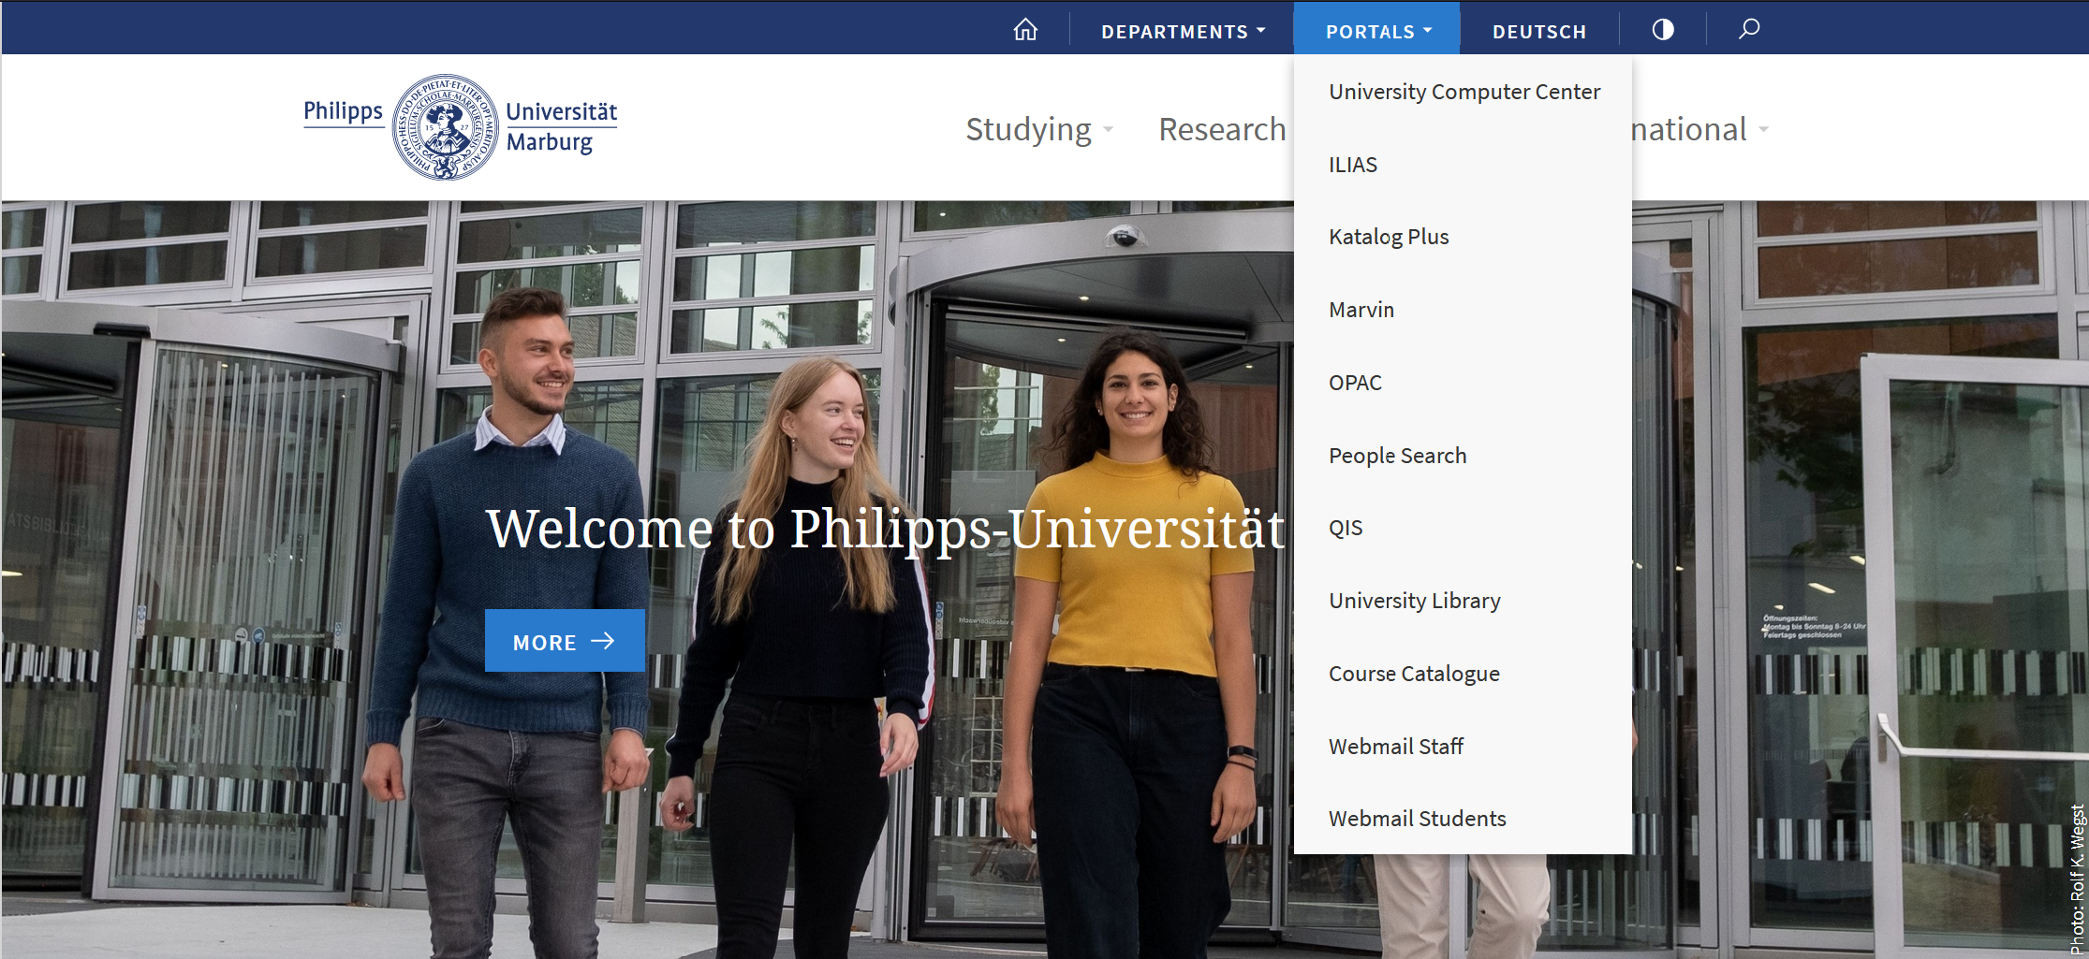
Uni Homepage - Portals
fachschaft@mathematik.uni-marburg.de
Notes:
<Foliennummer>

Slide 12

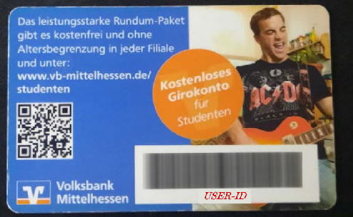
Ucard / Library Card
Front (Mensa)
Back with USER-ID
fachschaft@mathematik.uni-marburg.de
Notes:
<Foliennummer>

Slide 13
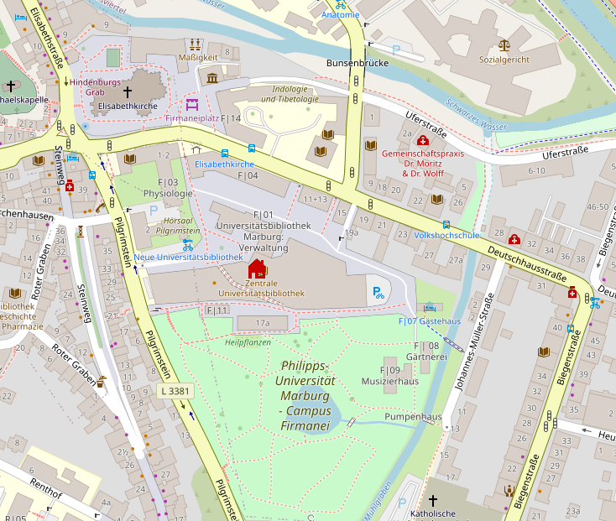
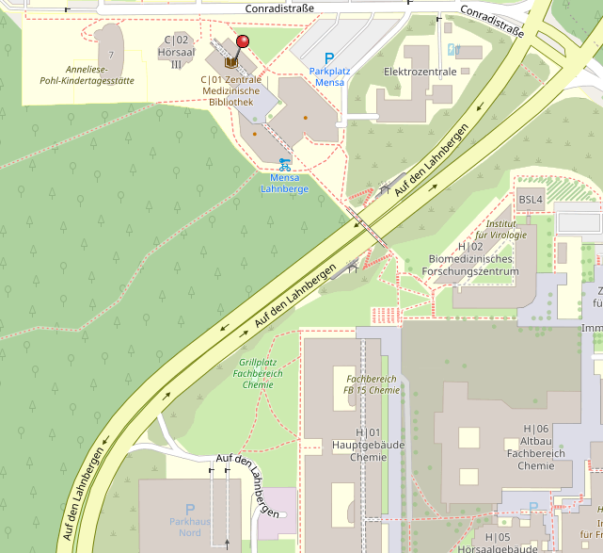
Libraries for activation
https://www.uni-marburg.de/en/ub
University Library
Central Medical Library
fachschaft@mathematik.uni-marburg.de
Notes:
<Foliennummer>

Slide 14
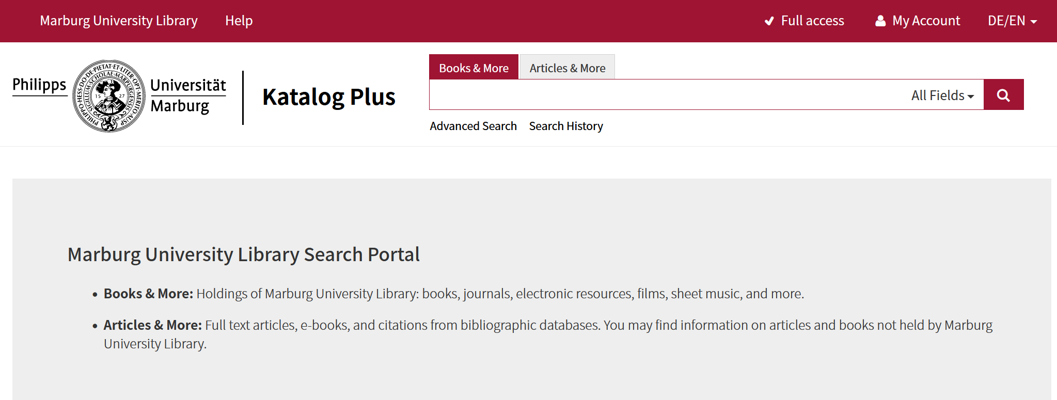
Katalog Plus
fachschaft@mathematik.uni-marburg.de
Notes:
<Foliennummer>

Slide 15
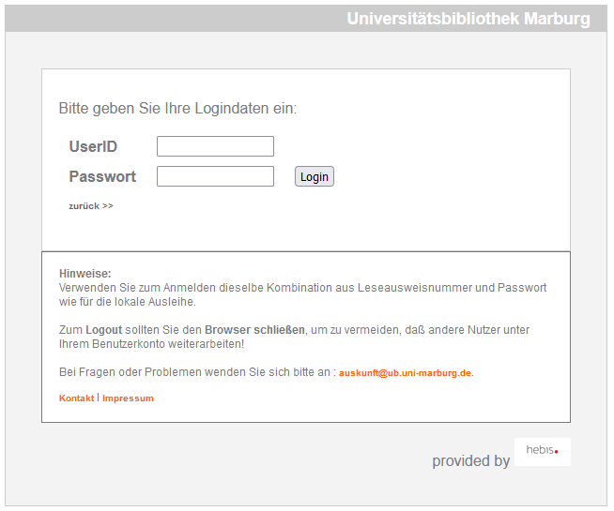
Katalog Plus
UserID = Barcode-Nr. (Back of the Ucard)
Passwort = Birthdate (Format: DDMMYYYY)
fachschaft@mathematik.uni-marburg.de
Notes:
<Foliennummer>

Slide 16
ILIAS
Information regarding lectures / Lecture slides
Handing in exercise sheets
Forums, surveys and exercise classes
https://ilias.uni-marburg.de/
fachschaft@mathematik.uni-marburg.de
Notes:
<Foliennummer>

Slide 17
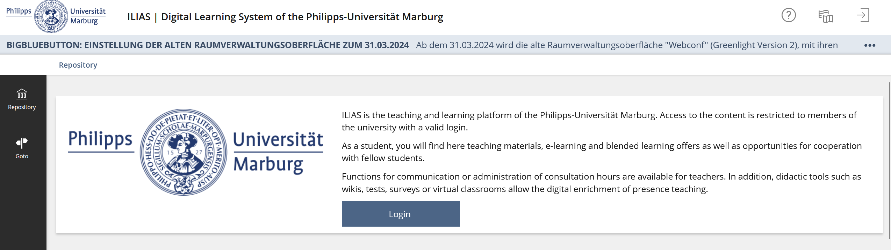
ILIAS
fachschaft@mathematik.uni-marburg.de
Notes:
<Foliennummer>

Slide 18
ILIAS
https://ilias.uni-marburg.de/goto.php?target=grp_3011772_rcode3uZPVfUfRz&client_id=UNIMR
fachschaft@mathematik.uni-marburg.de
Notes:
<Foliennummer>

Slide 19
Marvin
Examination registration
Certificates (e.g. matriculation) as PDF files
Module plan, timetable (reserve modules) and course catalog (preferably use study planner)
Student services: change personal data, manage payments
The personal semester fee and the transfer deadline are stored in Marvin:
    My studies - Student services – "Bills and payments" tab
Students can generate and download the Transcript of Records (ToR) and the complete transcript of records (really all modules taken) themselves in Marvin under My studies – My achievements
https://marvin.uni-marburg.de/
fachschaft@mathematik.uni-marburg.de
Notes:
<Foliennummer>

Slide 20
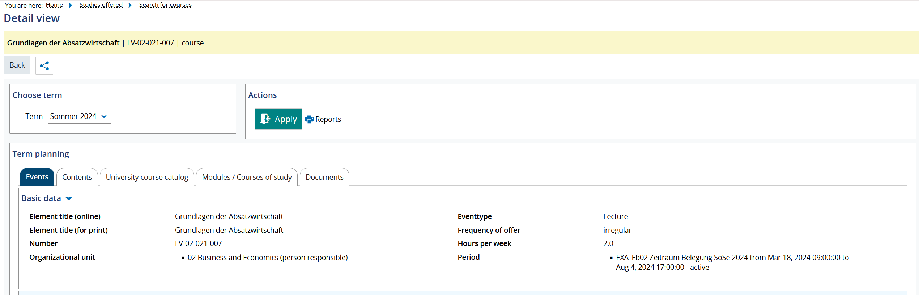
Registration for lectures in Marvin
fachschaft@mathematik.uni-marburg.de
Notes:
<Foliennummer>

Slide 21
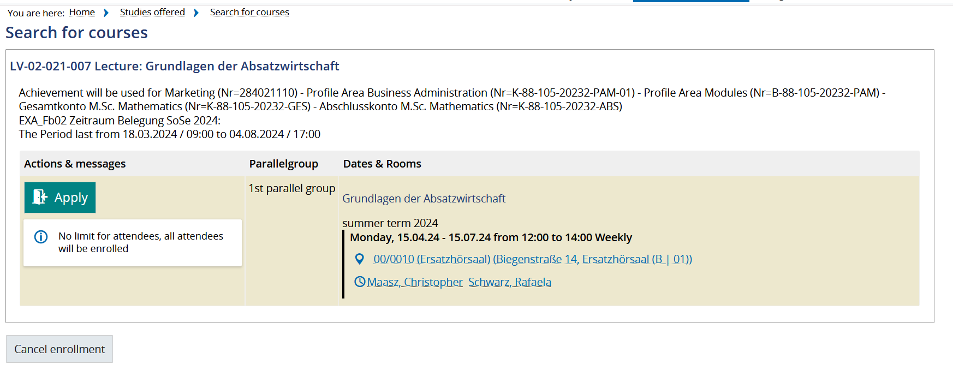
Registration for lectures in Marvin
fachschaft@mathematik.uni-marburg.de
Notes:
<Foliennummer>

Slide 22
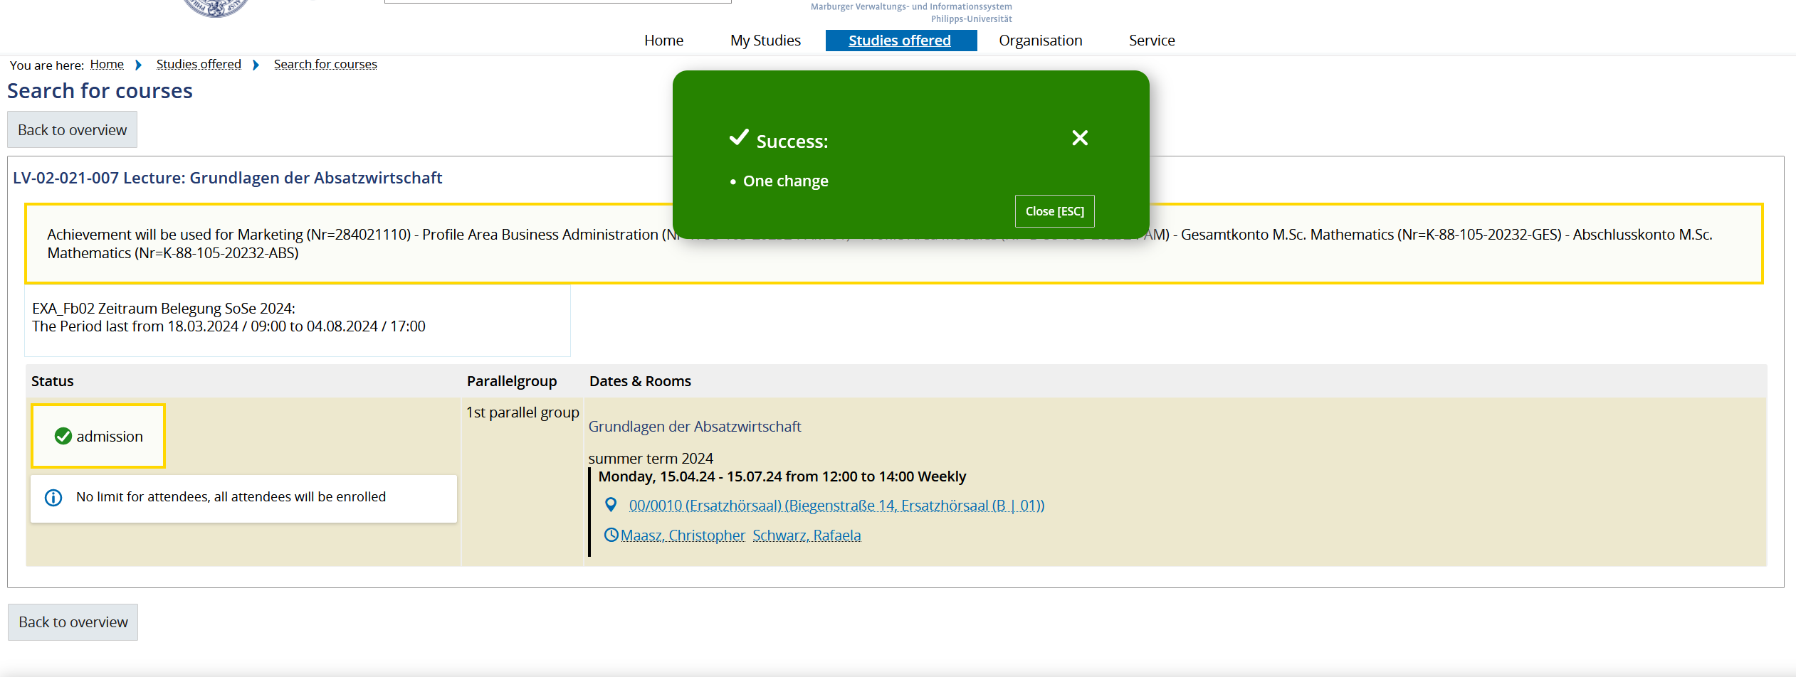
Registration for lectures in Marvin
fachschaft@mathematik.uni-marburg.de
Notes:
<Foliennummer>

Slide 23
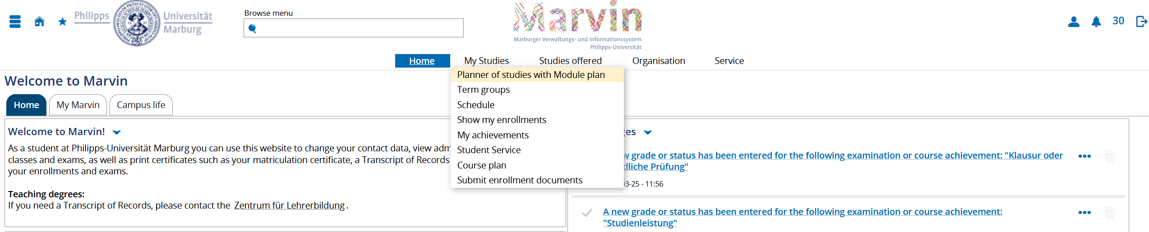
Registration for lectures in Marvin
Alternative: My Studies – Planer of studies with Module plan
fachschaft@mathematik.uni-marburg.de
Notes:
<Foliennummer>

Slide 24
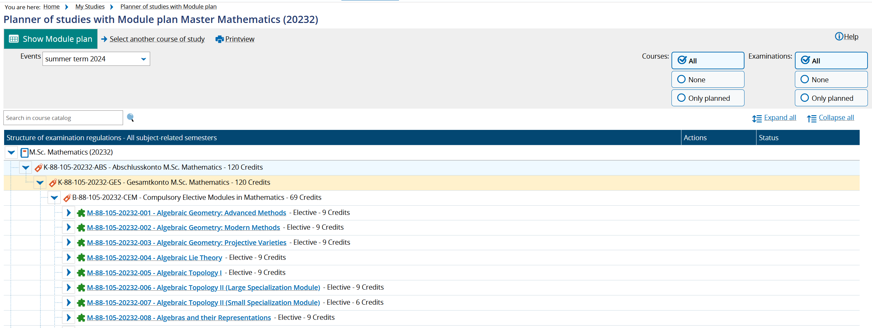
Registration for lectures/exams in Marvin
Alternative: My Studies – Planer of studies with Module plan
fachschaft@mathematik.uni-marburg.de
Notes:
<Foliennummer>

Slide 25
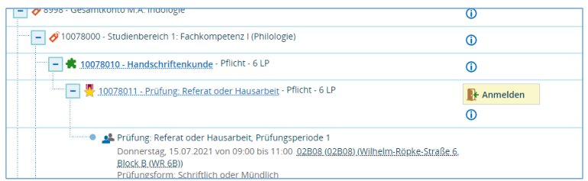
Examination registration in Marvin
Registering for lectures will first be possible by the end of the first third of the semester
fachschaft@mathematik.uni-marburg.de
Notes:
<Foliennummer>

Slide 26
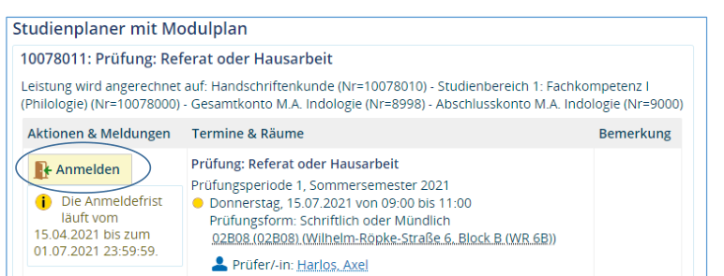
Examination registration in Marvin
If there are more than one appointments you have to be careful to chooes the right one.
fachschaft@mathematik.uni-marburg.de
Notes:
<Foliennummer>

Slide 27
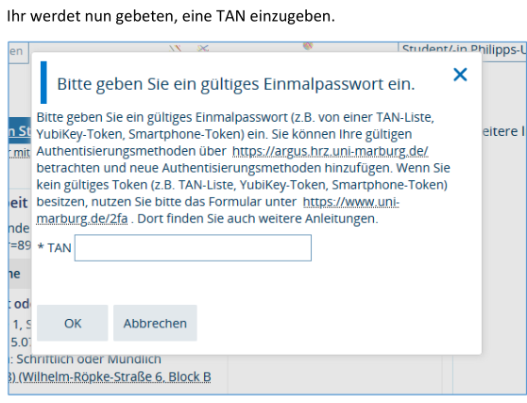
Examination registration in Marvin
Please note:
To enter the TAN, you can use a number from your TAN list or from another token (e.g. your Yubikey).
your Yubikey). If you do not yet have a token, please use the form
"Registered for exams in Marvin and don't have a token?" at https://www.uni-marburg.de/2fa.
There you will also find further instructions and can report lost tokens, for example.
You can view your tokens and create new tokens at https://argus.hrz.uni-marburg.de
(registration here is only possible with a second factor and from the university network).
fachschaft@mathematik.uni-marburg.de
Notes:
<Foliennummer>

Slide 28
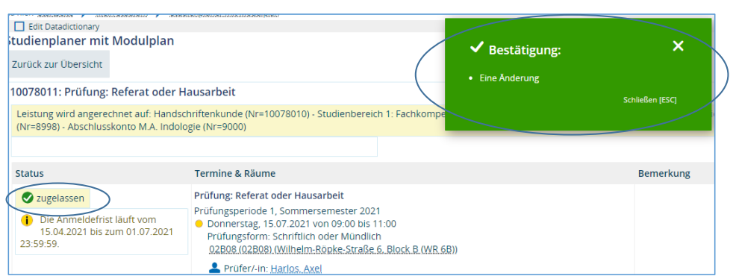
Examination registration in Marvin
Then you get a confirmation that the action was successful
fachschaft@mathematik.uni-marburg.de
Notes:
<Foliennummer>

Slide 29
Help
For students, the first point of contact is the department (student advisory service, examination office)
    The department offering the respective course/examination is responsible for registrations
    If you have any questions about your credit account, rebooking requests etc., please contact the department where you are studying
    Integrated Campus Management Coordinator: Dr. Andreas Lochmann (https://www.uni-marburg.de/de/fb12/fachbereich/dekanat/icm-koordination)
The Marvin e-mail address (marvin@uni-marburg.de) is responsible for questions that are not directly related to the course of study or achievements (e.g. login does not work, functions/menu items are not displayed, ...)
fachschaft@mathematik.uni-marburg.de
Notes:
<Foliennummer>

