Slide 1
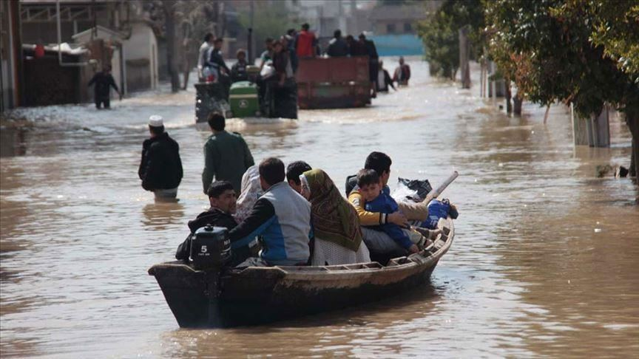

Islamic Azad University
The Role of NGOs in Flood Disaster Management
Experiences obtained from current floods in Iran
with the focus on flood in March, 2019, in Lorestan
By: Arman Nejat Dehkordi
Islamic Azad University, Tehran Branch, Iran
NaDiMa online Dialogue #4
27 October 2020

Slide 2
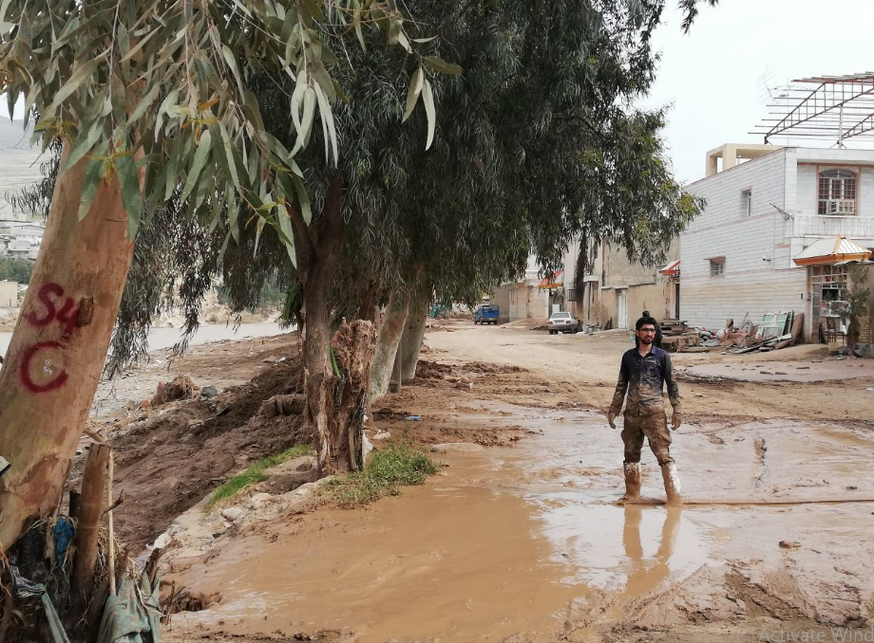
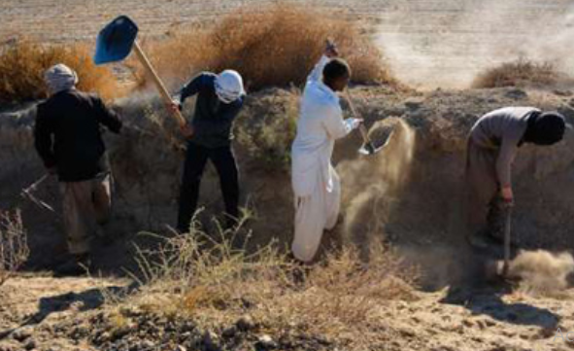
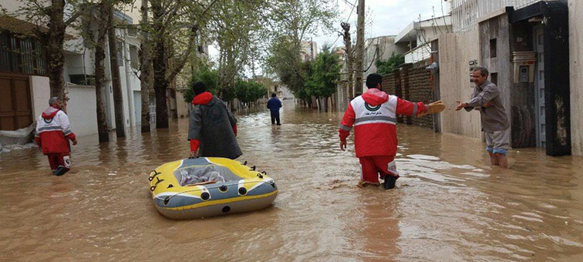
Topics:
Iran & Natural disasters
Flood in Iran; an Natural phenomenon, Social disaster (Current Floods in Iran)
Flood in Lorestan, 2019, As a Case Study;
The Nature of NGOs in Iran and the roles in disaster management
IAU Activities in Lorestan flood, 2019

Slide 3
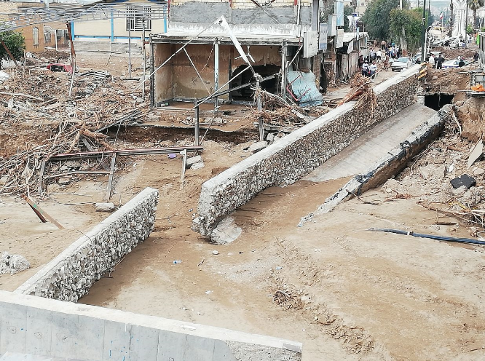
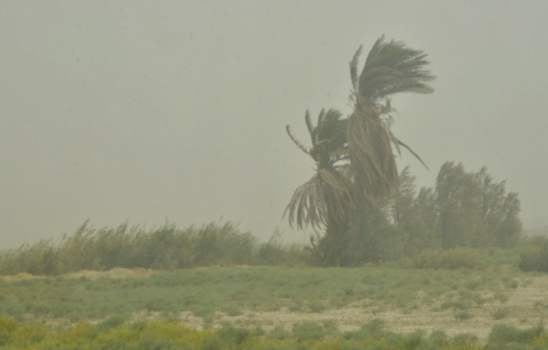
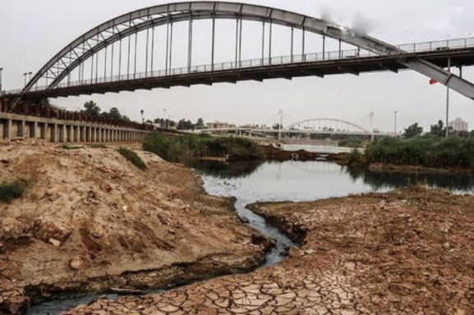
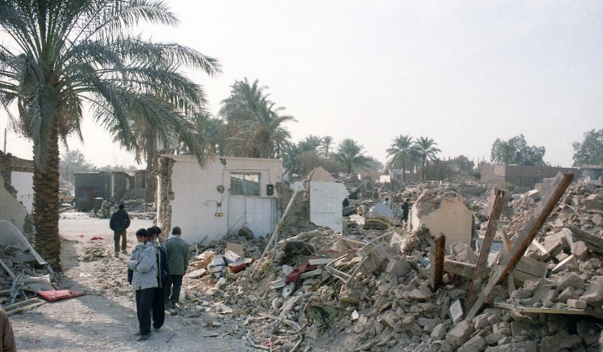
Mountains ~ 60 %
Desert and Arid ~ 40 %
Identified 31 Types of Disasters in Iran
Sistan Winds
Disastrous Prone Country
Iran
&
Natural disasters
Lorestan Floods
Bam earthquake
Khuzestan draughts
Earthquakes have killed more than 180, 000 people during the last 90 years
Floods have inflicted losses worth nearly $690 million, on Iran’s economy in the fiscal 2019-20

Slide 4
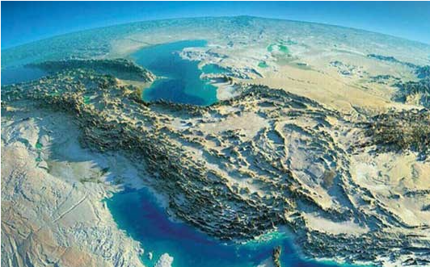
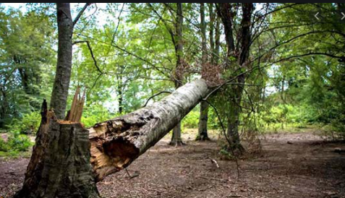
Flood in Iran
Natural phenomena - Social disasters
flooding is one of the most dangerous natural hazards
Two factors lead to
disastrous flooding
Climatic and Geographic factors such as the Zagros and Alborz Mountains
keep the center of the country dry
Combination of
land use
soil type
destruction of forests and pastures
a large amount of rainfall fails to penetrate into the ground and runs off rapidly

Slide 5
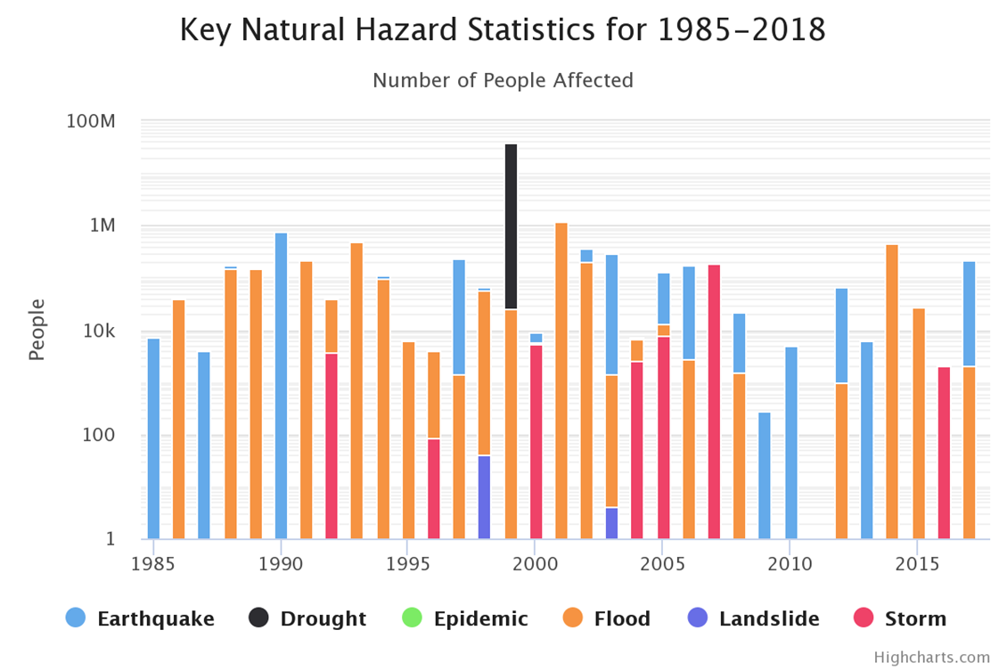
Main hazard risks to Iran, measured by number of people affected, for the period 1985-2018 (source: World Bank, 2019).
numerous floods in Golestan
In 1987 Tajrish flood with about 300 people killed
Sistan historical floods
in 2019
floods are considered as one of the least unexampled disasters in Iran due to the extent of the areas all over the country.

Slide 6
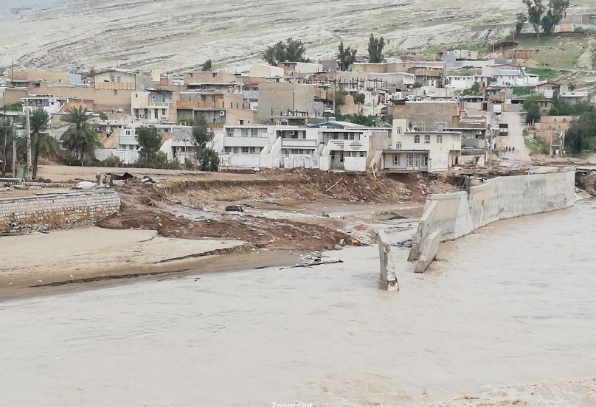
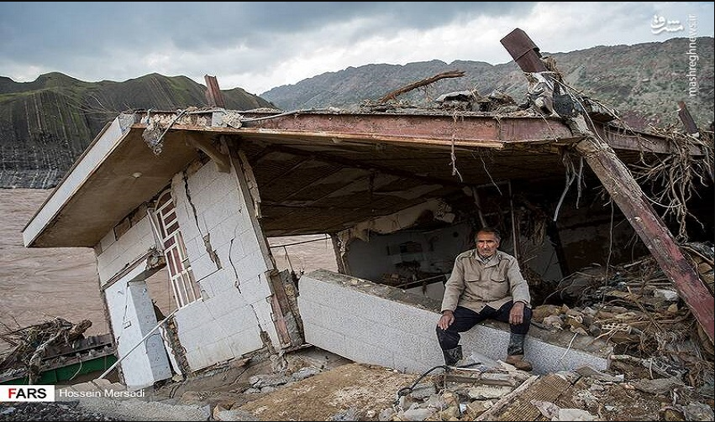
Effects of flood in 2019
total rainfall
19 × its previous year
3 × the normal rate was reported
March
17th to 22nd
the periods of rainfall in short interval
24th to 26th
March 31st to April 1st
Affected About 200 cities and 4,300 villages by flood
80 compatriots lost their lives
A significant risk of additional flooding from Karkheh Dam (Khuzestan)
Estimated 35,000 milliard Tomans of damage

Slide 7
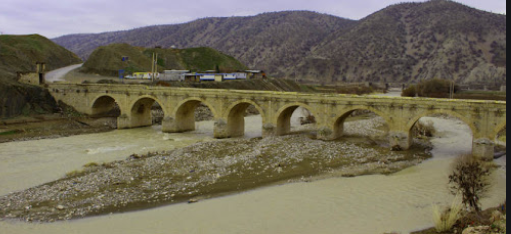
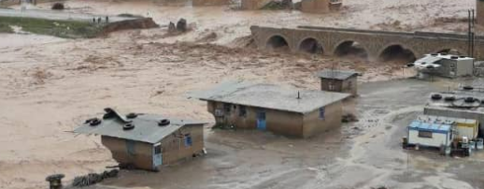
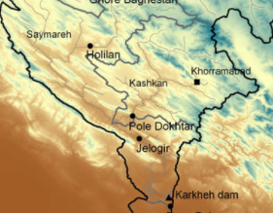
Floods in Lorestan 2019
as a Case study
What happened in Lorestan?
Kashkan River
Pole Dokhtar
The epicenter of the flood in Lorestan
One of the important sub-catchments of the Karkheh
located in the middle of the Zagros Mountains with an area of 9000 square kilometers

Slide 8
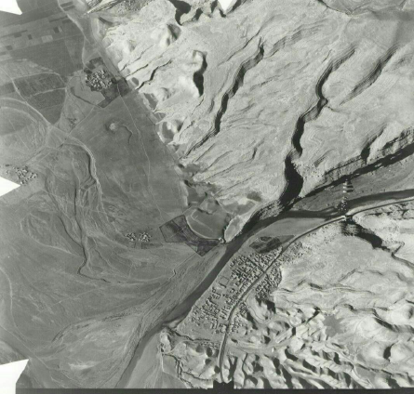
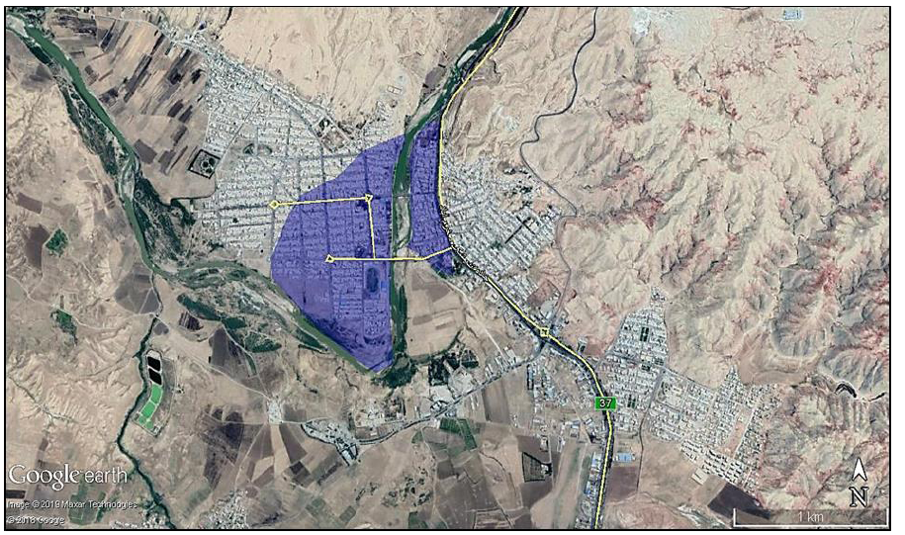
Increased precipitation in March 2019 compared to the previous periods
almost 100% compared to the long-term period of 50 years
250% compared to its previous year
Climate change;
Changes in the catchment area of the Kashkan River
land use changes
Rural and urban development along with frequent droughts

Slide 9
Kashkan River
Two time periods of rainfall In Lorestan flood (Dubai recorded at Poldakhtar station)
24th to 26th (3350 cubic meters per second)
March31st to April 1st (7,000 cubic meters per second)
According to estimates and the latest studies
This amount of Dubai is equivalent to Dubai with a return period of more than 500 years.
1800 villages were affected by the floods
200 villages were completely surrounded
15 people lost their lives
70 km of the main and important road to Poldakhtar city were destroyed
The telecommunication networks were completely damaged

Slide 10
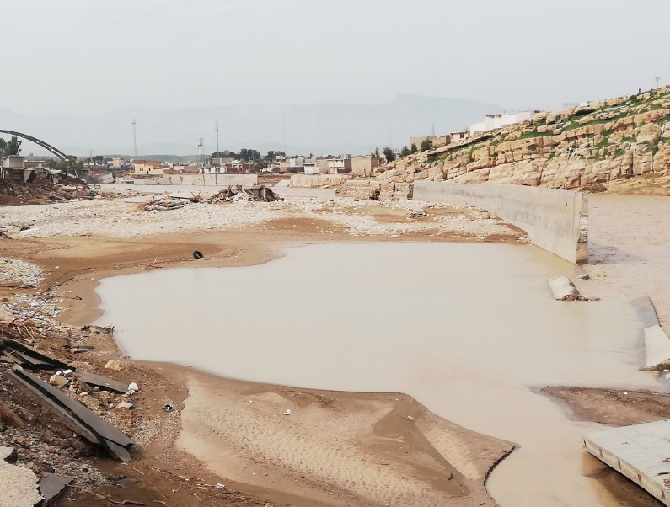
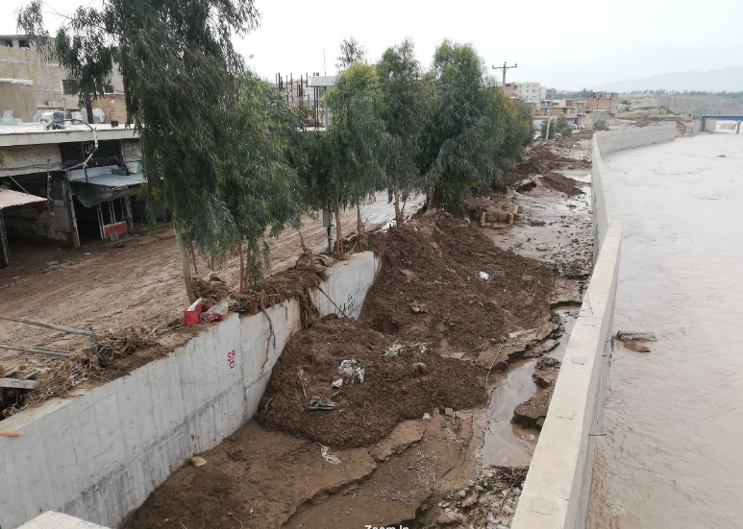
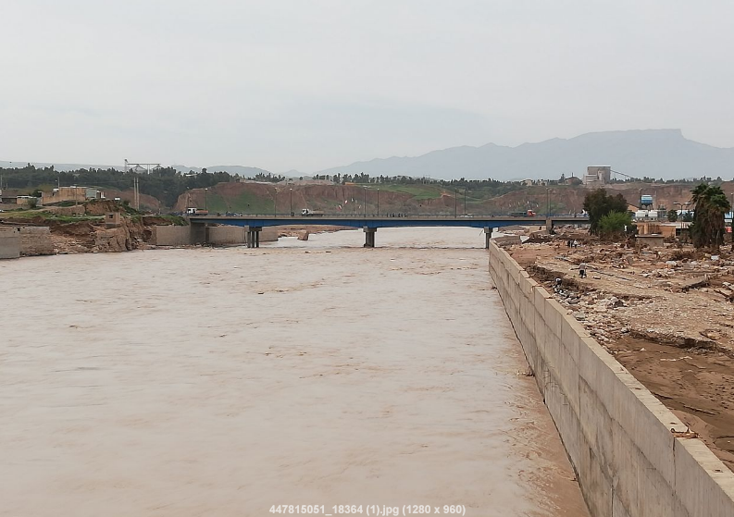
Effective Factors made the flood much more destructive
Human factors
innovations in the river bed and flood zones
Incorrect placement of protective walls
Reduction of river cross section
Non-engineering blockage of one of the spans of the bridge located on the river in the city
Scouring created in the place of protective walls

Slide 11
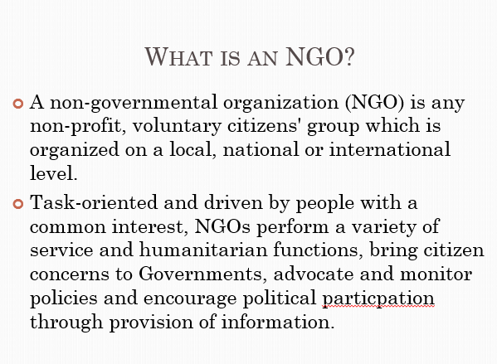
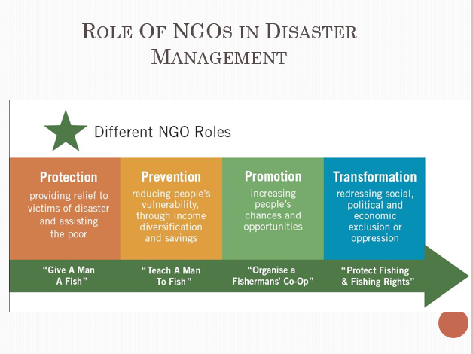
NGO in the mentioned flood

Slide 12
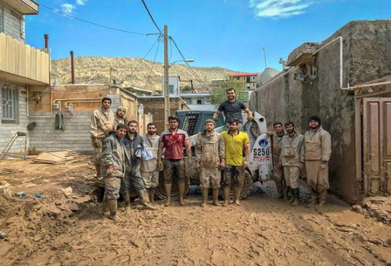
NGO in the mentioned flood
All the services provided when the flood occurred More than 70 of Governmental organizations were available
NGO is very wide Spread in Iran
More than 1200 NGO in Lorestan, flood
Variety of different social group.

Slide 13

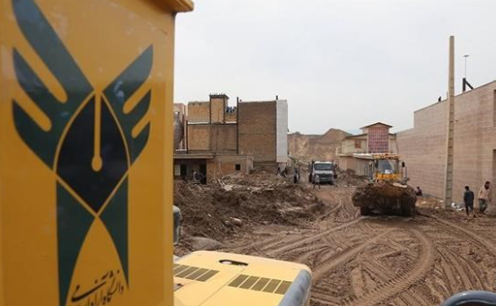
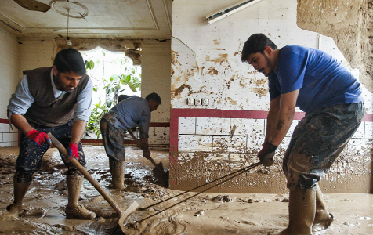
Academic operation organization, First Academic-NGO
A new experience in reducing the risks of floods
Islamic Azad University (IAU)
in the form of an academic operational organization
took an immediate action with a purposeful intention to provide its services

Slide 14
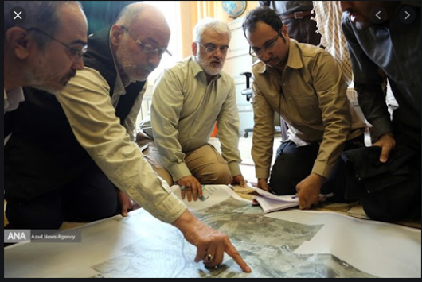
Islamic Azad university efficient activities taken in the form of an academic executive organization:
Scientific documentation
Illustration of the condition of the river and the surrounding environment in post-flood conditions
Providing technical and scientific advice
Clearing areas AND Reopening routes
Construction of temporary housing AND Removal of the destroyed buildings and machinery
Providing scientific analysis of the incident and creating decision-making for managers.
Defining scientific dissertations and research projects in order to answer the questions

Slide 15
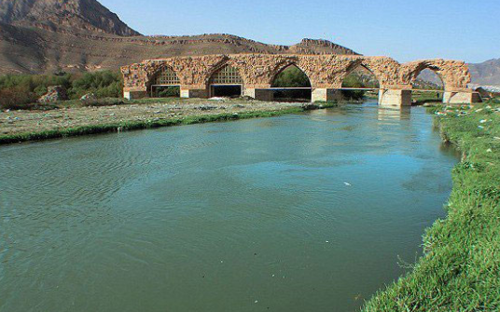
Thank you

