Slide 1
The Economics of Natural Disasters
4. Economic Effects

Slide 2
Disasters and Trade
Gassebner et al. (2010) expect that disasters reduce exports, whereas the effect on imports is unclear.
Disasters have to meet one of the following criteria: (i) number of killed is no fewer than 1000; (ii) the number of injured is no fewer than 1000; (iii) number of affected is no fewer than 100,000; or (iv) damages are no less than $1 billion.
A standard gravity model is estimated with disaster counts for both exporters and importers included.

Slide 3
Disasters and Trade
A simple disaster count variable shows no effects. If the count-variable is scaled by the country’s surface area, the authors find significant results:
  Overall, disasters reduce both exports and imports.
  The less democratic a country is, the more imports are lost.
  The reduction of exports does not depend on the level of democracy.

Slide 4
Disasters and Growth
Cavallo et al. (2013) study the effect of catastrophic disasters on economic growth.
Disasters are defined by the share of the population killed and a threshold, e.g., corresponding to the 1% most severe disasters.

Slide 5
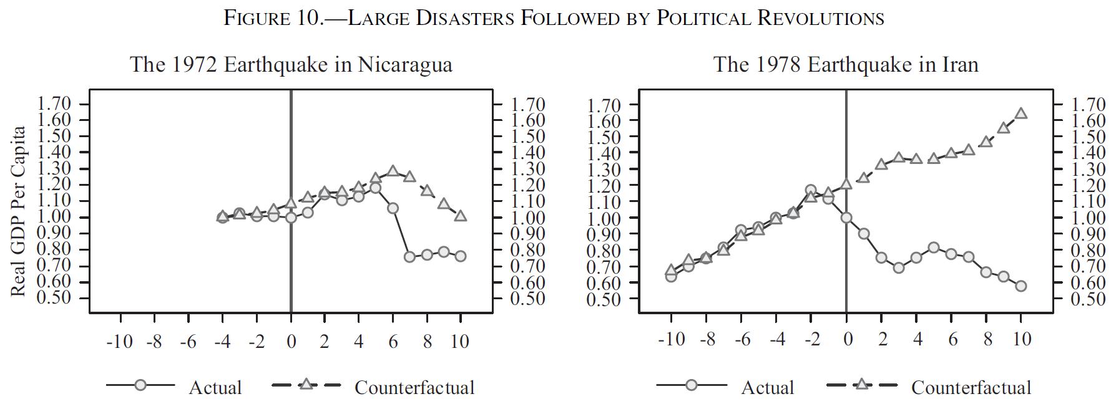
Disasters and Growth
Results indicate that catastrophic natural disasters do not have a significant effect on subsequent economic growth, except in the case where they are followed by a radical political revolution.

Slide 6
Disasters and Growth
Given the absence of impacts on per capita incomes, it is likely that the disaster’s effect is mostly felt through reduced consumption that finances reconstruction or long-run higher levels of indebtedness.

Slide 7
Disasters and Growth
Felbermayr and Gröschl (2014) build a comprehensive database of disaster events and their intensities from primary geophysical and meteorological information.
Their results reveal a substantial negative and robust average impact effect of disasters on growth.
International openness and democratic institutions reduce the adverse effect of disasters.

Slide 8
Disasters and Growth

Slide 9
Disasters and Growth
Klomp (2016) studies the effect on night-time light intensity.
Disasters fulfill one of the criteria:
  number of killed is no less than a thousand
  the number of injured is no less than a thousand
  number of affected is no less than a hundred thousand
  the amount of damages is no less than $1 billion.
Hydrological, meteorological, geophysical, and climatic disasters are distinguished and disasters are normalized by land area.

Slide 10
Disasters and Growth

Slide 11
Disasters and Growth

Slide 12
Disasters and Growth

Slide 13
Disasters and Growth
Most disaster types have no long-run growth effects and geophysical disasters even show a positive effect.
75% of the economic impact takes place on the regional level.
Small-scale disasters have no effect on growth.
Very large disasters have a stronger effect than other large disasters.

Slide 14
Disasters and Growth
Breckner et al. (2016) test whether the economic impact of disasters can be mitigated by insurance market development.
Their results suggest that private insurance penetration and a stable, well-institutionalized environment complement each other in accommodating the negative effects of natural disasters.

Slide 15
Disasters and Growth
Caruso (2017) studies the long-term effects of disasters on individuals in Latin America between 1900 and 2000.
Natural disasters affect the education, health, labor outcomes and wealth of the individuals exposed. The most fragile period for any individual to receive this kind of shock is during the first years of life and school age.
Mothers exposed to shocks are more likely to affect their children’s education than exposed fathers.

Slide 16
Disasters and Growth
Boustan et al. (2020) study the effects of natural disasters in the United States between 1920 and 2010.
Severe disasters (those killing 25 people or more) increase out-migration rates at the county level by 1.5 percentage points and lower housing prices/rents by 2.5 to 5 percent.
Effects are stronger for more severe disasters.
The results indicate that disasters reduce productivity in local areas, outweighing any destruction of the local housing stock.

