Slide 1
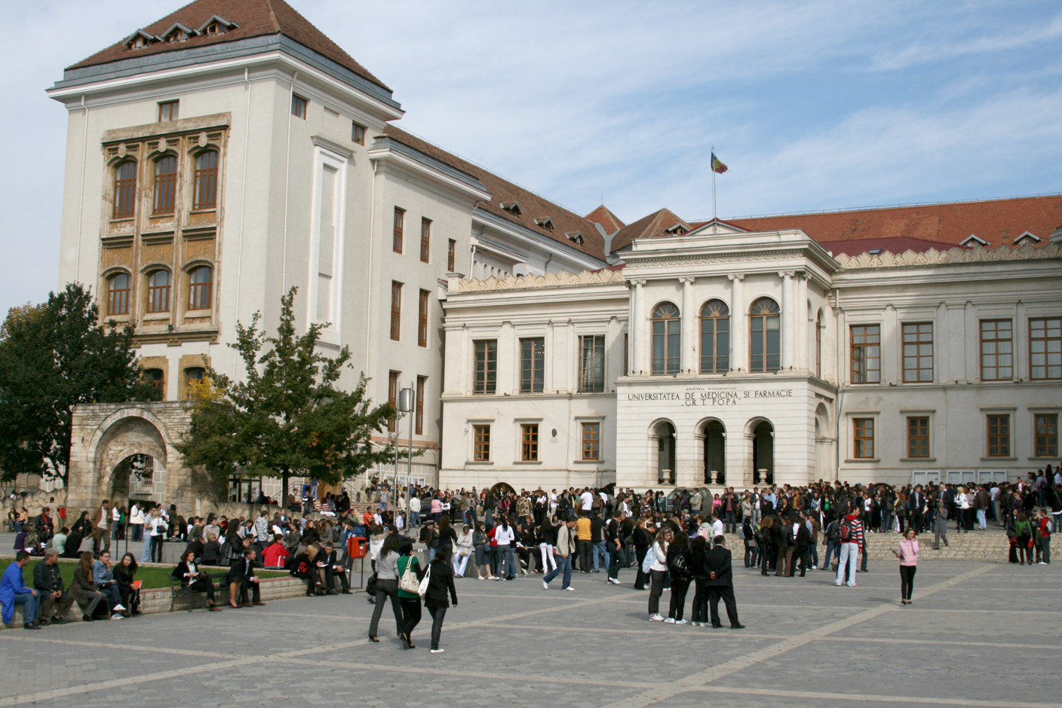

Slide 2
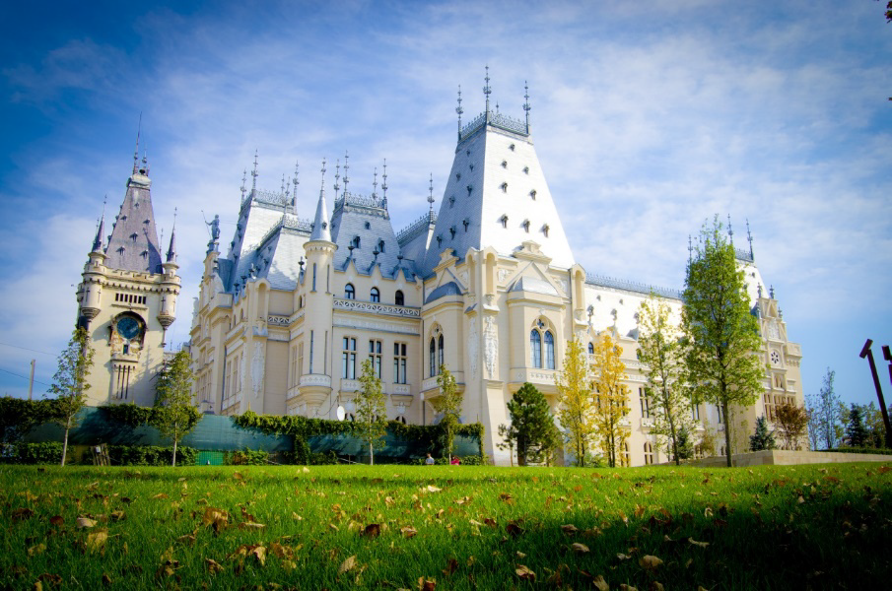
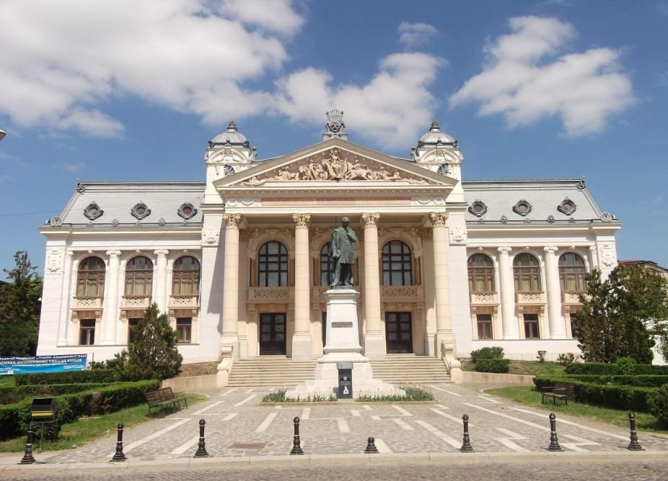
IASI – ROMANIA
This year Iasi celebrates 610 years of history.
Iasi is the second largest city in Romania, located in the North-East, at a distance of about 500 kilometers from the capital.
Spread over seven valleys, nicknamed "city of the seven hills", with a pleasant temperate - continental climate, Iasi has almost 300,000 inhabitants. It is not a metropolis, but it does have a young and cosmopolitan spirit, due to its almost 50,000 students.

Slide 3
5 reasons to study at UMF IASI
Quality of education certified in all E.U. countries;
Awarded diplomas and degrees are recognized in the E.U. countries, which enable foreign graduates to integrate different medical networks;
Opportunity to study in English or French;
Affordability of tuition fees and reduced living costs in Iasi, in comparison with other university cities;
Easy access: international airport, at 8 km from the city center, connected to most of the major cities in Europe

Slide 4
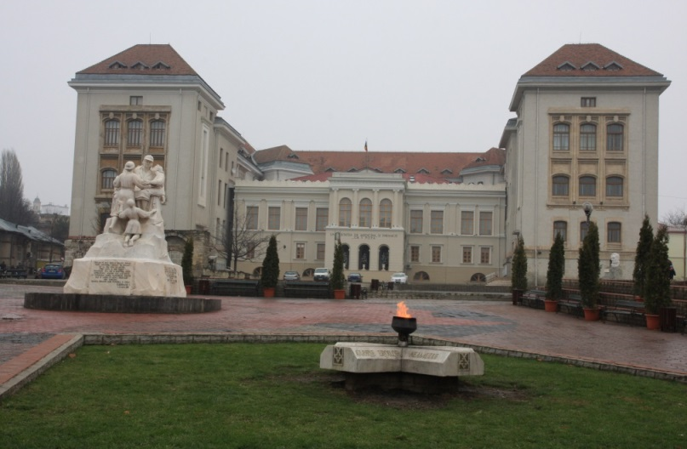
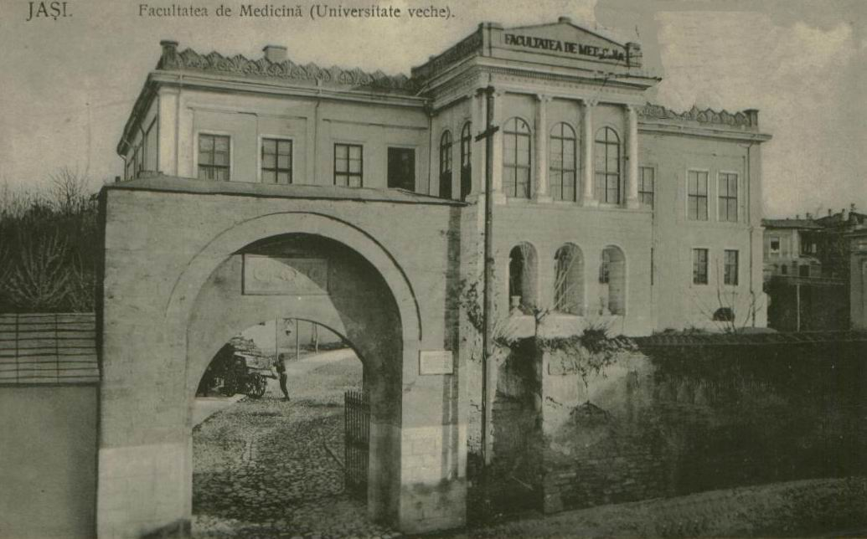
SHORT HISTORY
created as Faculty of Medicine – 1879
later associated with the Faculty of Pharmacy and Faculty Of Dentistry – 1935
named after one of the most representative Professors of Comparative Anatomy - Grigore T. Popa – 1991
comprises also the Faculty of Bioengineering - 1994

Slide 5
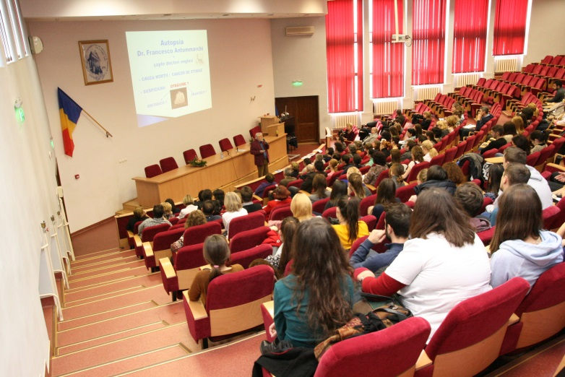
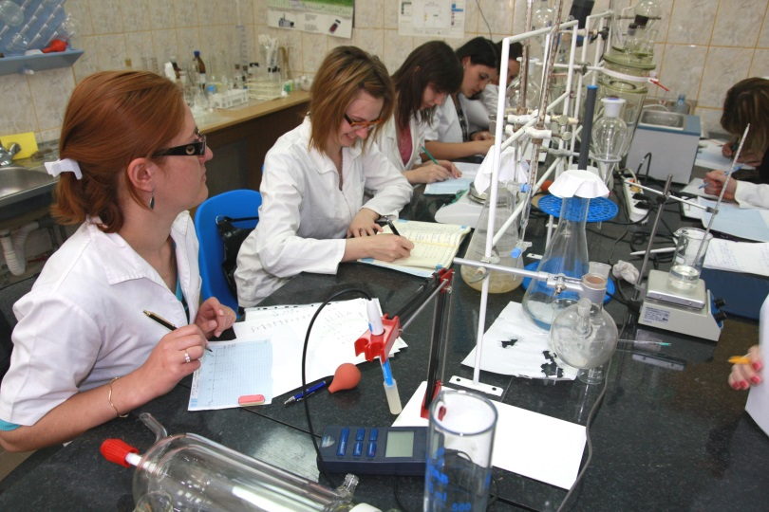
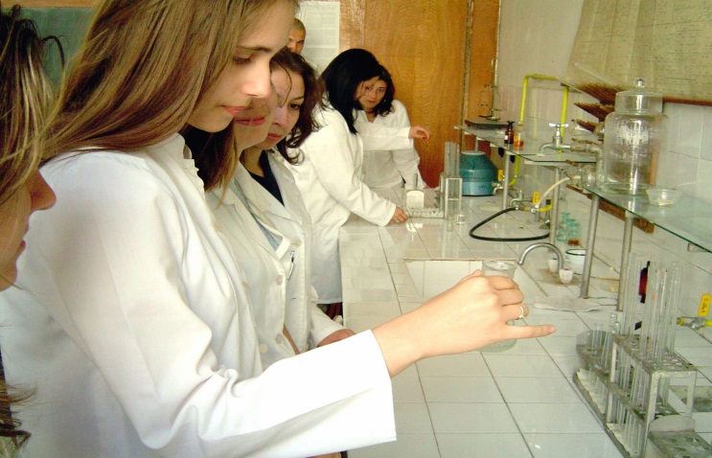
FACULTY OF MEDICINE
Medicine – 6 years, 360 credits in Romanian, English, French
Nursing – 4 years, 240 credits in Romanian
Nutrition and dietetics – 3 years, 180 credits in Romanian
FACULTY OF DENTAL MEDICINE
Dental Medicine – 6 years, 360 credits in Romanian, English, French
Dental Technique - 3 years, 180 credits in Romanian
FACULTY OF PHARMACY
Pharmacy– 5 years, 300 credits in Romanian and English
FACULTY OF MEDICAL BIOENGINEERING
Bioengineering: 4 years, 240 credits in Romanian
Balneo-physio-kinetotherapy: 3 years, 180 credits in Romanian and
English

Slide 6
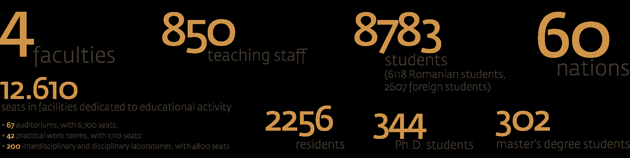
OUR UNIVERSITY IN FIGURES

Slide 7
INTERNATIONAL OFFICE
We assist and advise members of our academic community in all international agendas and, in close collaboration with the faculties, we design and promote programs for internationalization
57 agreements with universities and hospitals from countries like: Belgium, Czech Republic, Finland, France, Germany, Italy, UK, Holland, Poland, Spain, Bulgaria, Republic of Macedonia, Slovenia, Hungary, Greece, Turkey and Luxembourg.
For years now, we have been participating in reputable educational fairs around the world (8 editions of EAIE), taking advantage of this instrument’s potential for effective communication with prospective students or partners.
TEAM:
Prof. Dr. Monica Hancianu - Vice-Rector of International Relations
Mihaela Vacariu Sirotta – Erasmus Officer
Andreea Dobrea – International Relations Officer

