Slide 1
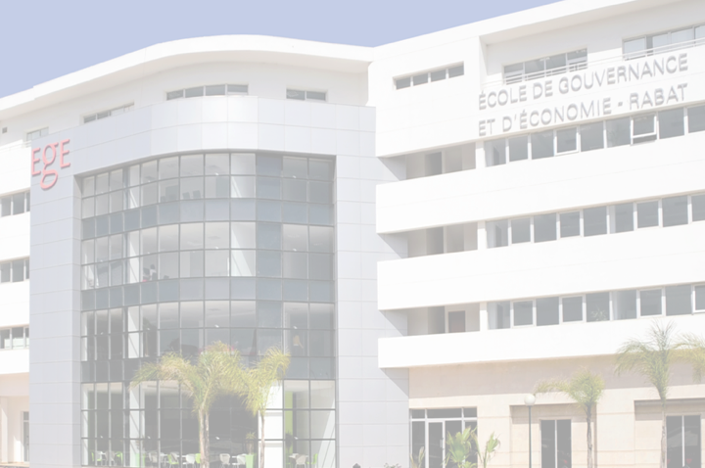
Hallo
مرحبا
Hello!

Slide 2

Overview
Founded in 2008, the school of Governance, Economics and Social Sciences commonly known in French as ‘Ecole de Gouvernance et d’Economie, Rabat’, is an institution of Higher Education with focus on teaching and research in social, political and Economic sciences. It is located in Rabat, the capital city of Morocco, and is part of Mohammed VI Polytechnic University.

Slide 3




EGE RABAT IN 2017-2018
More than 355 students
57 professors and administrative staff
139 scholarships
More than 100 international students

Slide 4
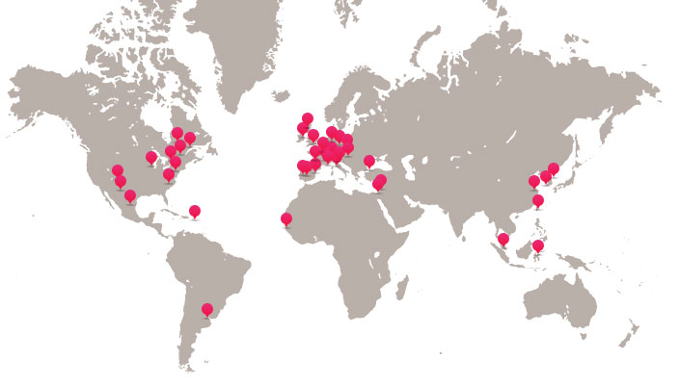
International partners
More than 80 partner universities in Africa, Asia, North America, Latin America and Europe. These partnerships offer students several possibilities of mobility according to their academic, professional or personal projects, reciprocally it welcomes a large number of international students (about 20% of the student promotion is made up of international students from our network of partners).

Slide 5


These partnerships offer students several possibilities of mobility according to their academic, professional or personal projects, reciprocally it welcomes a large number of international students
522 Moroccan students benefited from international mobility in the 80 partner universities
As part of international mobility, 954 international students were received by EGE, of which more than 21 nationalities represented

Slide 6
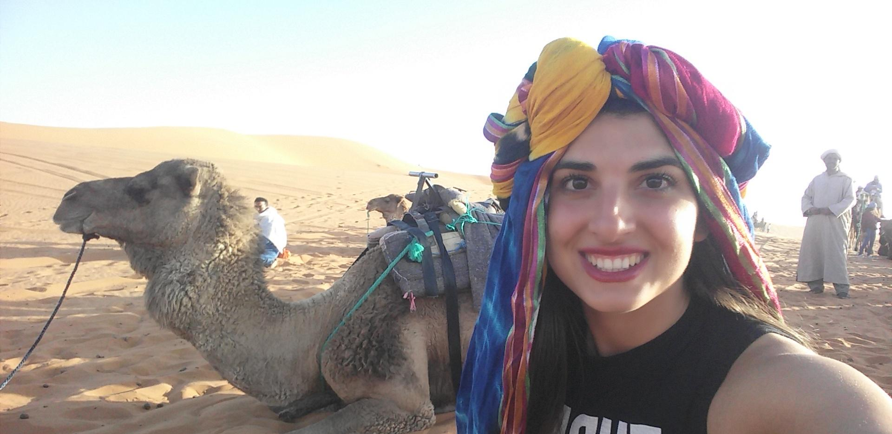
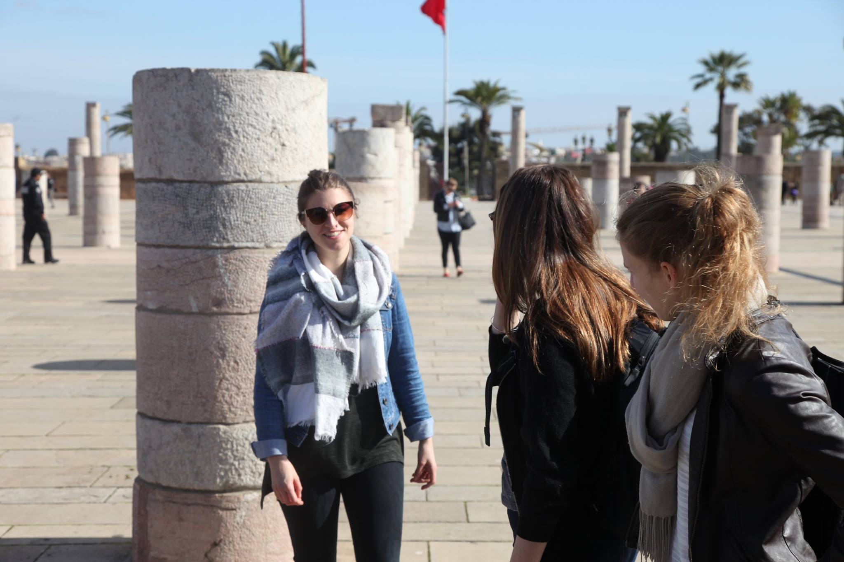
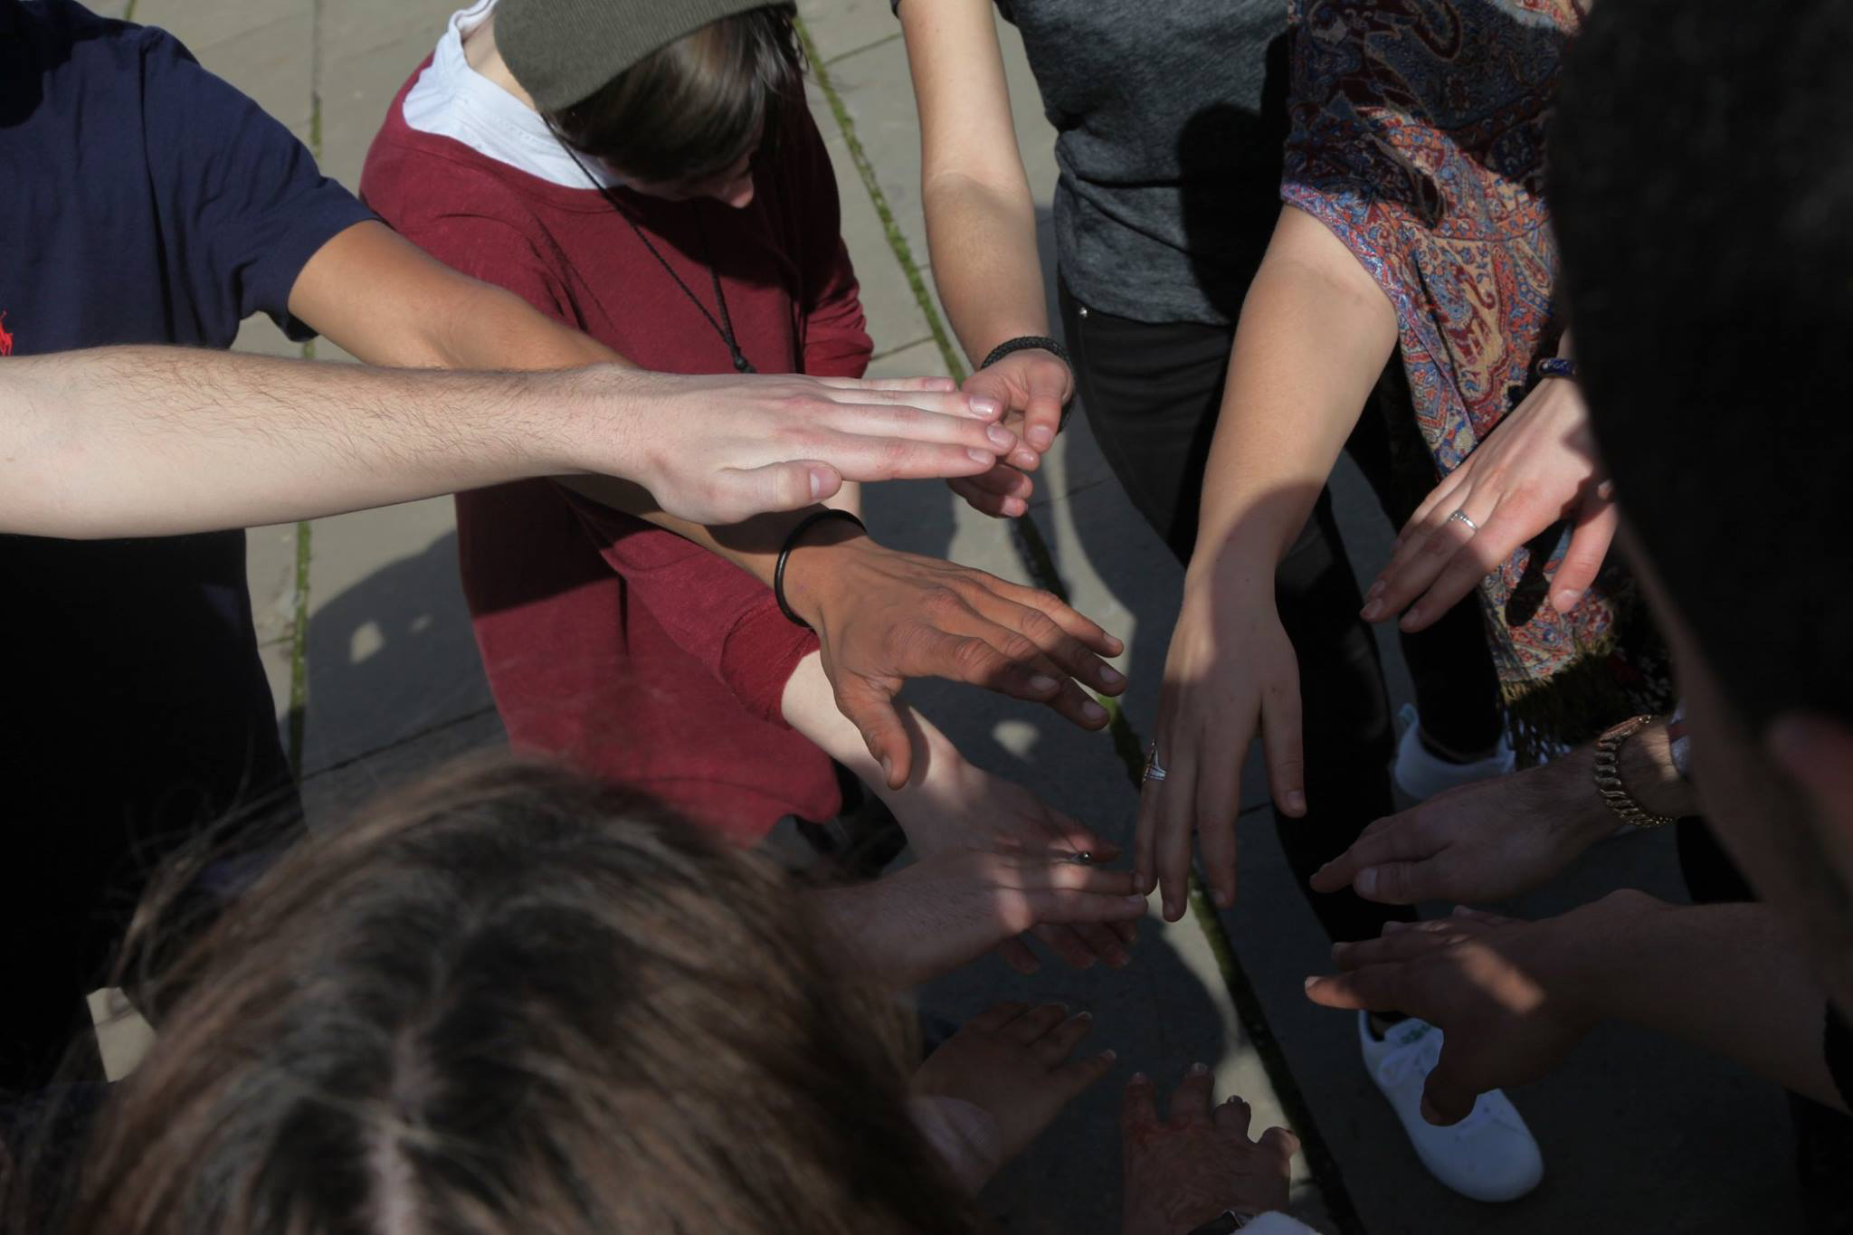
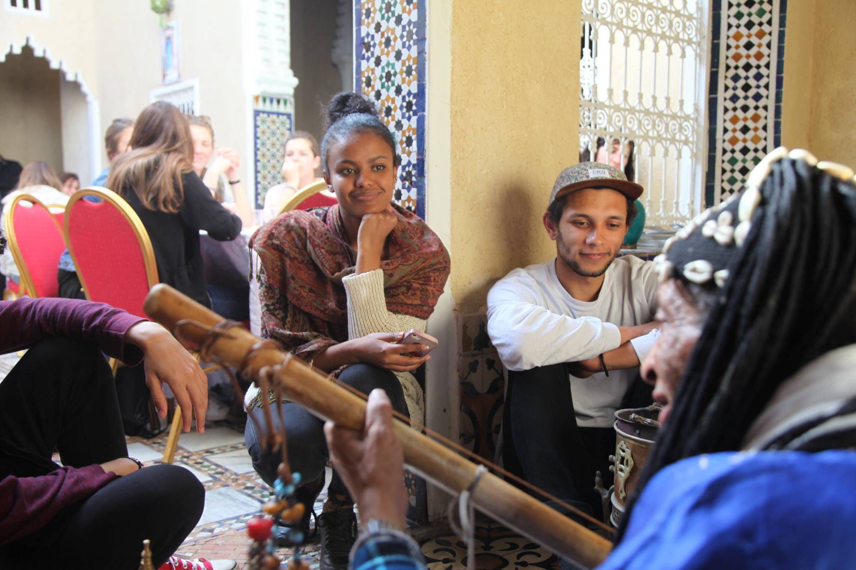
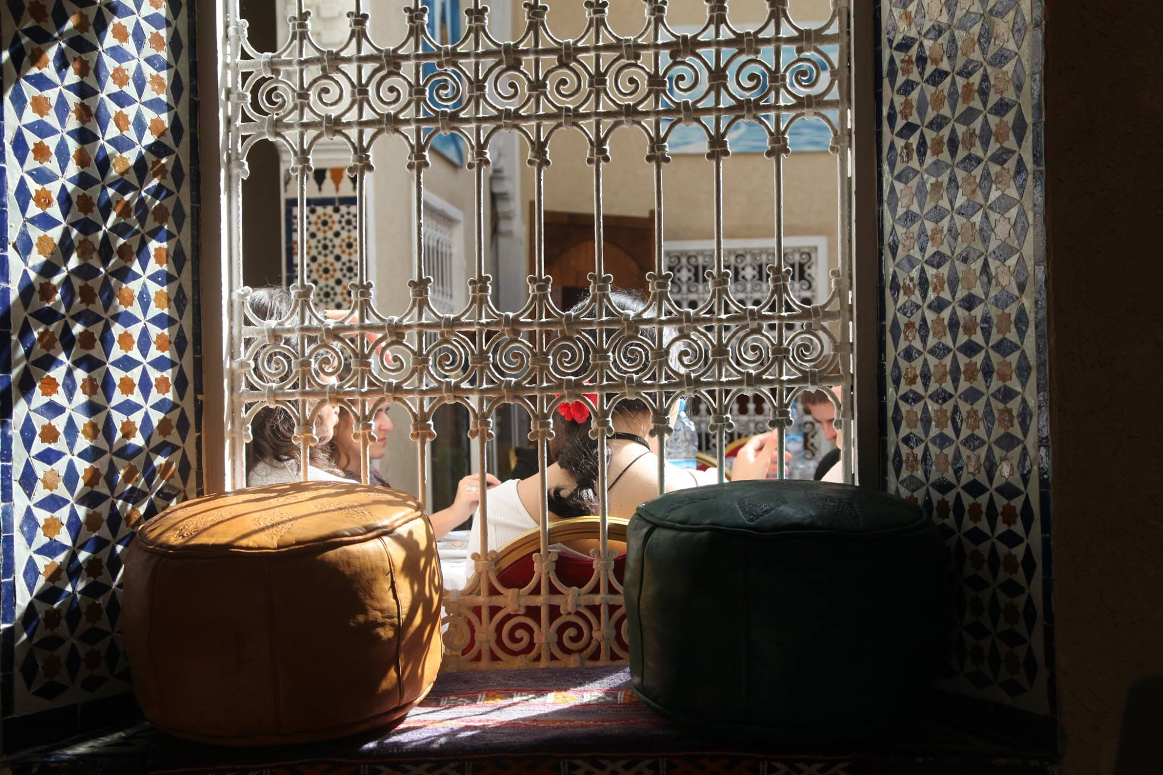
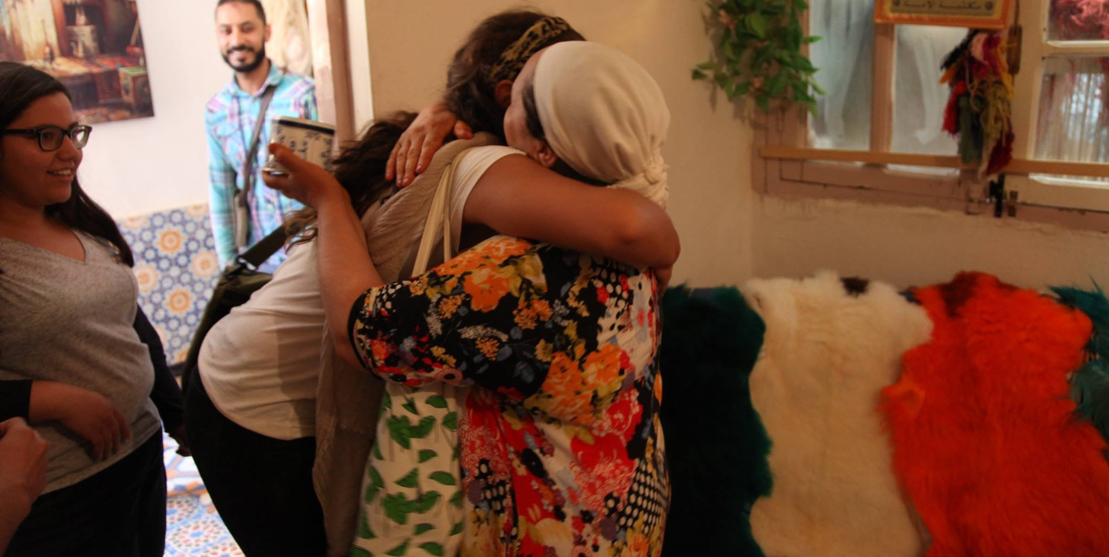
Our international students in morocco

Slide 7




Master programs
The Rabat School of Governance and Economics currently has on offer two graduate programs in partnership with prestigious institutions in Europe like Paris Dauphine, Sciences Po Aix, University of Turin or Sophia Antipolis in Nice
• International Economics (ECO)
• Comparative Analysis of Mediterranean Societies (COSM)

Slide 8
The Arabic Program PEASS

Slide 9
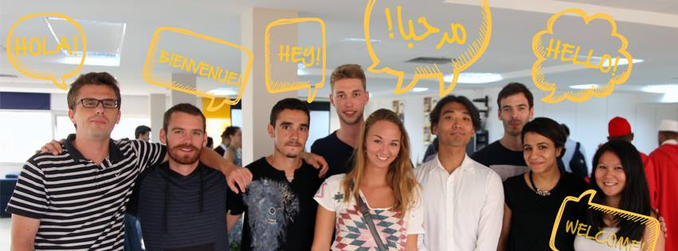
The PEASS is a program of linguistic intensification on university objectives, proposed by EGE Rabat. It is intended for non-Arabic speaking students who wish to develop their level and use of the standard Arabic language, while improving their understanding and ability to analyze the major economic and social political issues of the contemporary world.

Slide 10

Staff mobility in EGE
Our International office provides EGE members with the unique opportunity to gain a short but valuable international experience by joining a team from another member organization and hosting a professional from abroad. The duration of an exchange may vary from one week to two weeks.
More than 30 members of staff has benefied from the opportunity to visit with Erasmus+ a partner university last year.
Erasmus+ for staff allows us to learn new ways to manage our tasks and exchange our know-how with your foreign colleagues.

